Slide 1
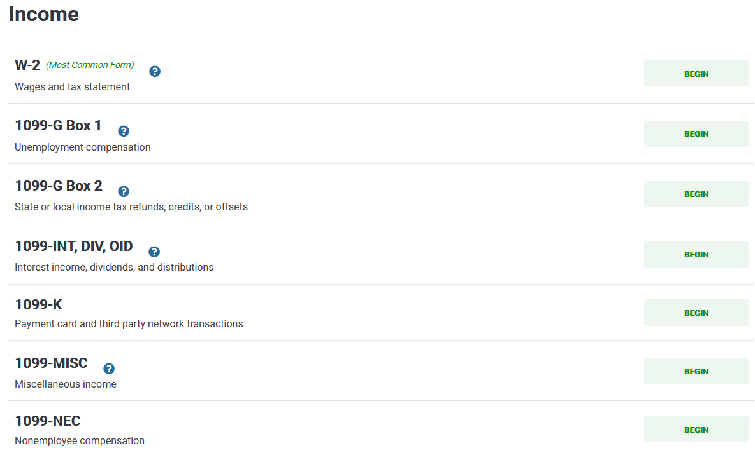
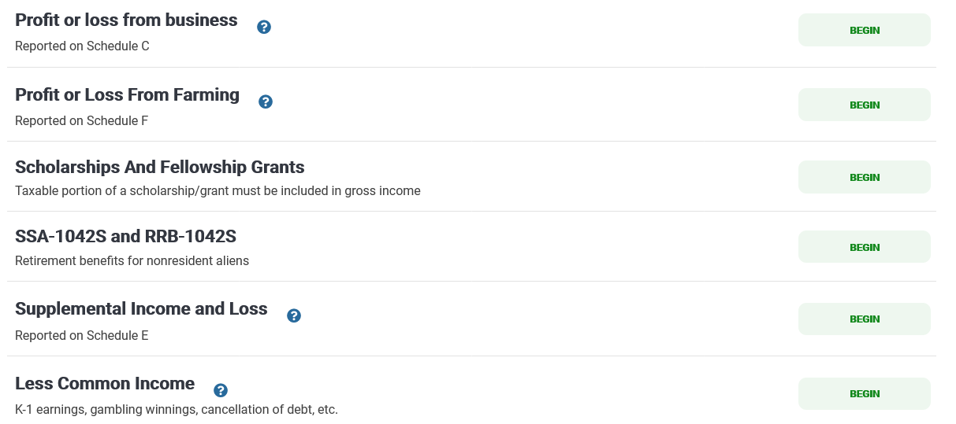
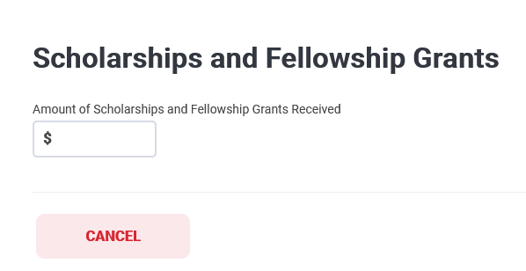

Did you receive Form 1042-S for a Scholarship that exceeded tuition, books, and fees?
(Income Code 16 Listed on Form 1042-S Box 1)
If you were awarded a scholarship that exceeded tuition, books, and fees in 2023, you should have received Form 1042-S. (Check your Sprintax account )
Note: Do not enter scholarship amount in this section if you have a scholarship treaty. If you have a scholarship treaty, only enter your 1042-S information in the 1042-S section (next slide).
Do you have a scholarship treaty? Please view here (page 13)
to ensure that your country of residence has a scholarship treaty.
If you have a scholarship treaty, DO NOT enter the scholarship
amount in this section. But be aware that you must still enter your
Form 1042-S information in the 1042-S section on the website
(view next slide).
Enter the Gross Income amount in TaxSlayer. You may find the Gross Income on box 2 on your Form 1042-S.

Slide 2
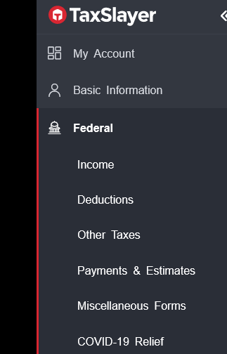
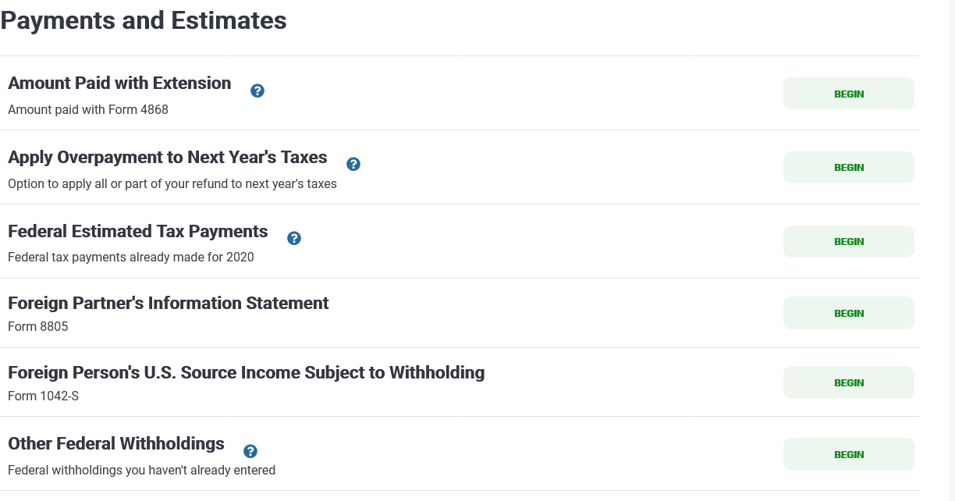
Did you receive Form 1042-S?
In addition to adding your gross income on the Scholarship and Fellowship Grants tab, you must enter the rest of the 1042-S information in the Form 1042-S section: Foreign Person’s U.S. Source Income Subject to Withholding.

Slide 3
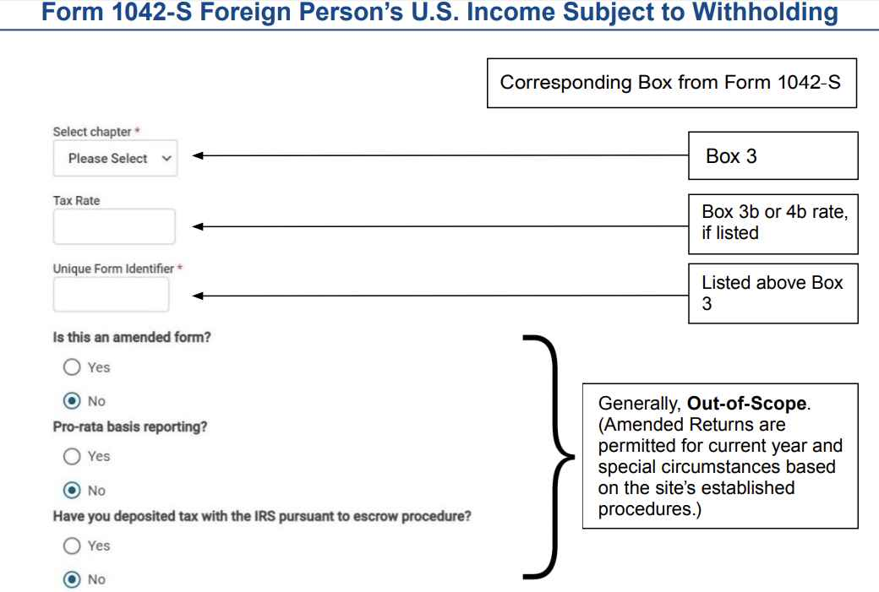
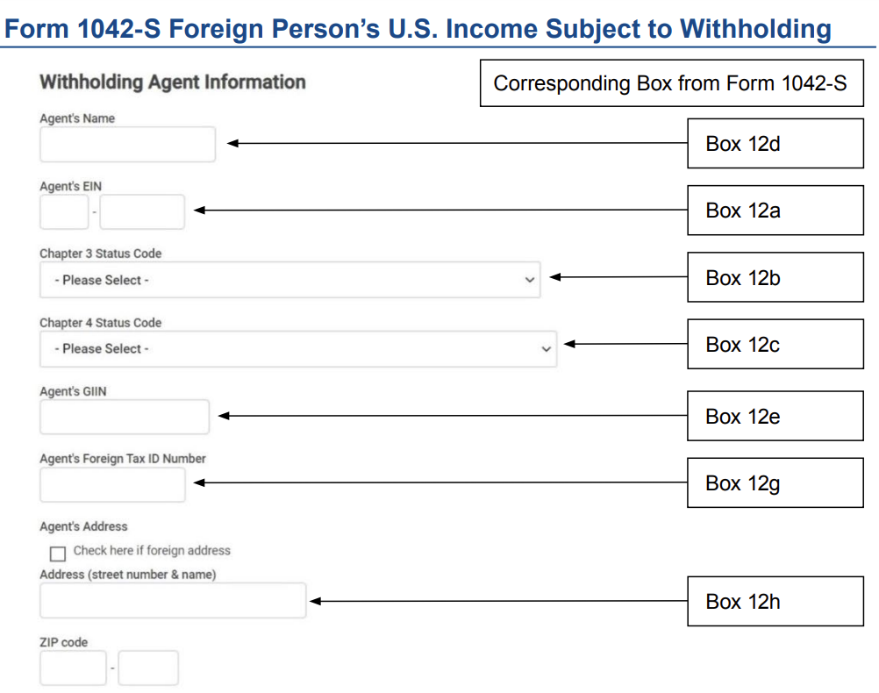
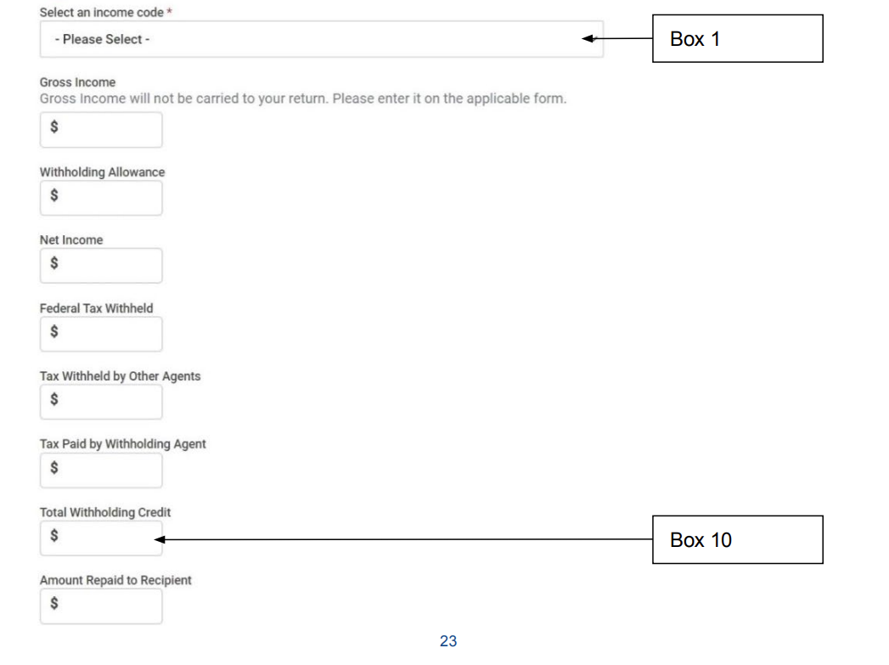
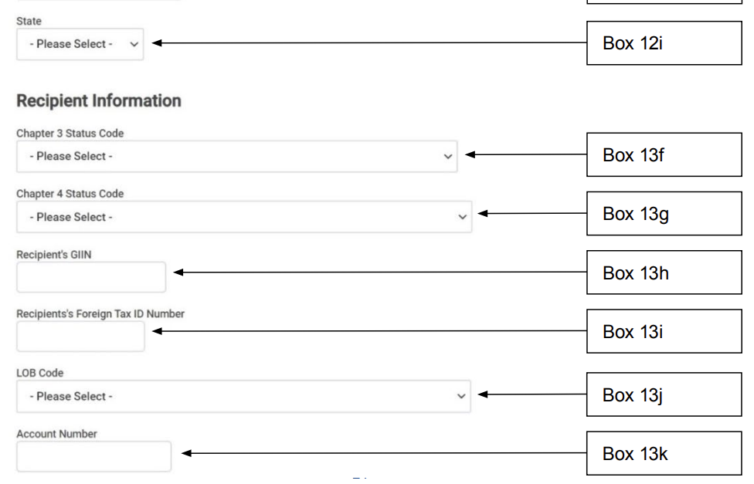
Chapter 3 Status Code *
Box 3a
If TaxSlayer Requests this Box
Box 2
Box 5
Box 6
Box 7a
Box 8
Box 11

Slide 4
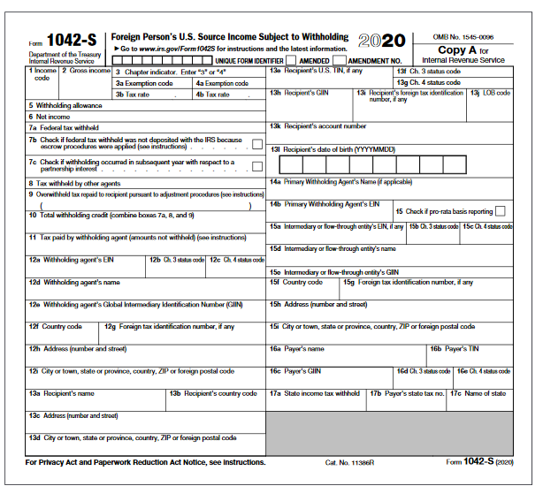
Select chapter
Please Select
Tax Rate
Chapter 3 Status Code
(if TaxSlayer Requests this Box)

