Slide 1
Reporting Dividend Income or Capital Gains/Losses
The following slides explain how to report dividend income and capital gains or losses
To report this type of information, you must have received a tax document, such as a 1099-B or 1099-Div for the current tax year.
Note, the slides that follow will generate Schedule NEC

Slide 2
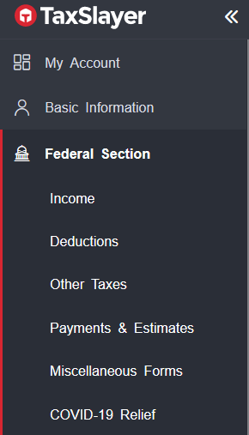
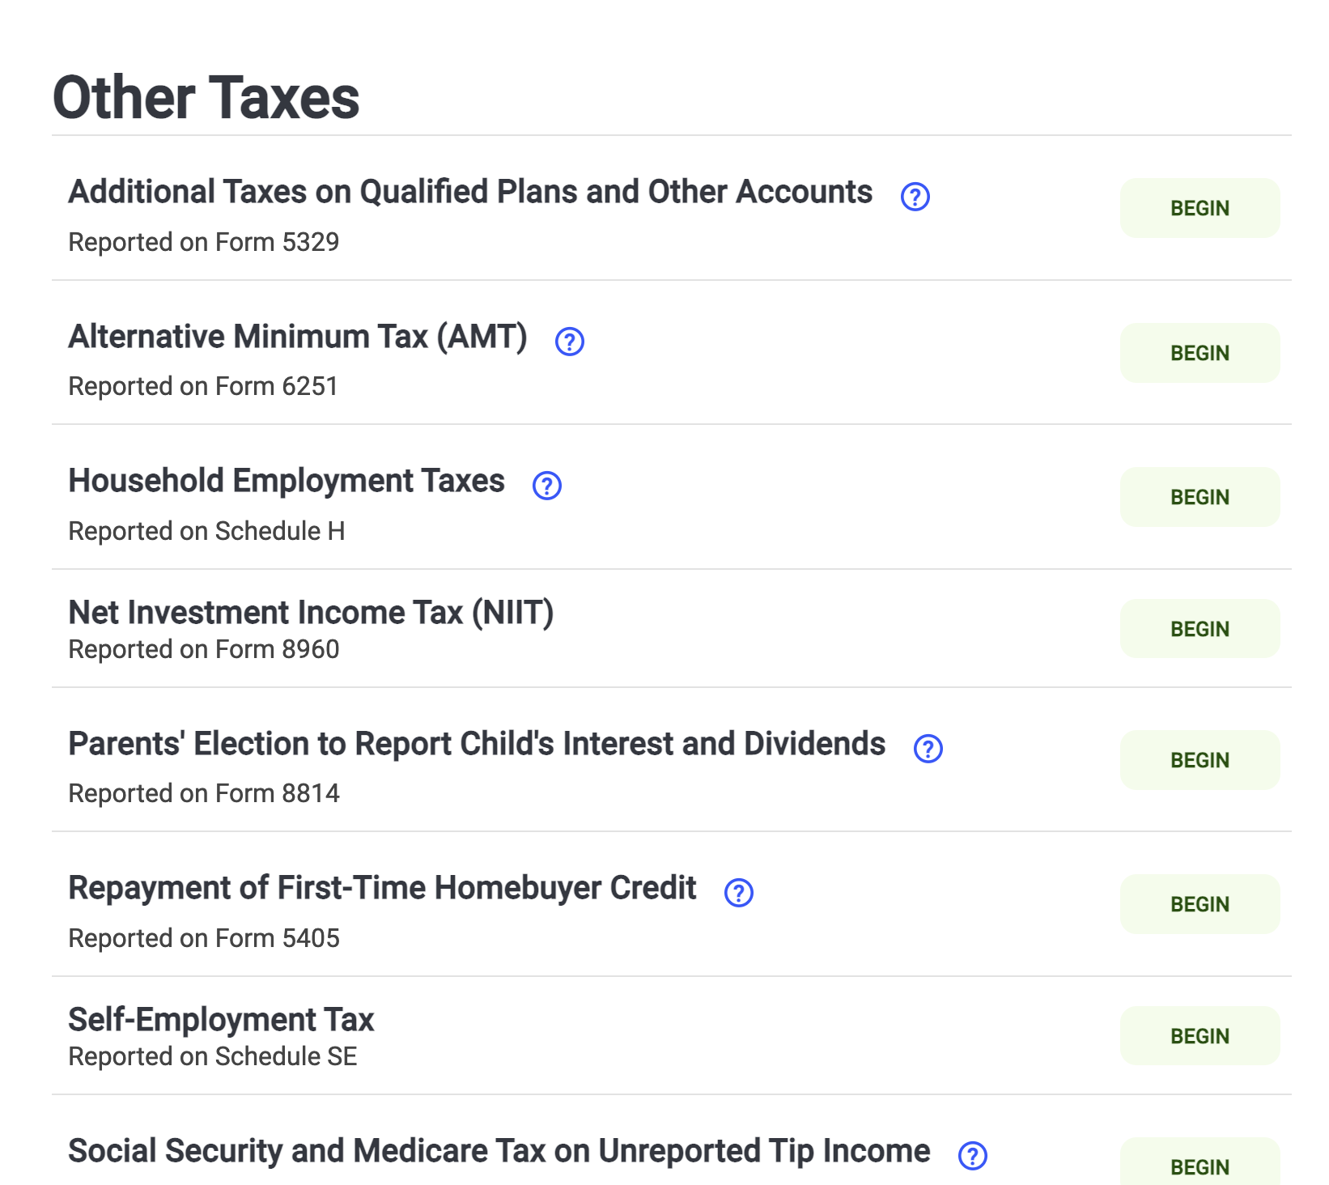
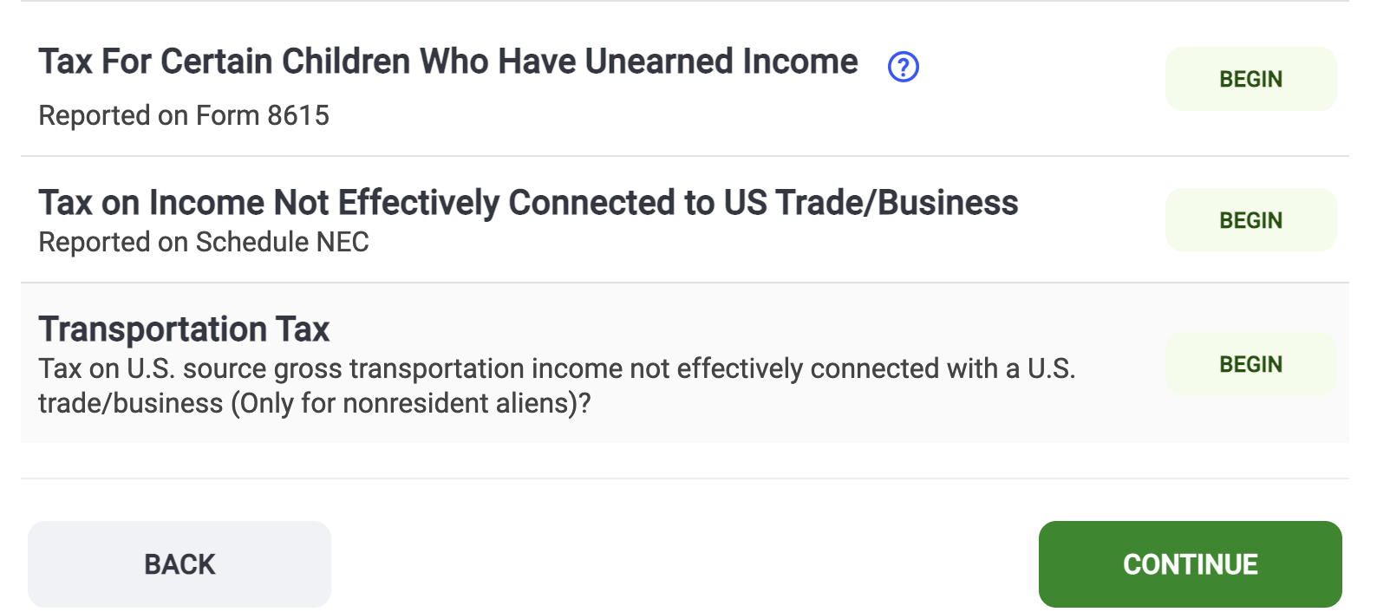
Did you have Capital Gains/Losses or Dividend Income during the current tax year?
Click Other Taxes
Click
Tax on Income Not Effectively Connected to US Trade/Business
(Schedule NEC)

Slide 3
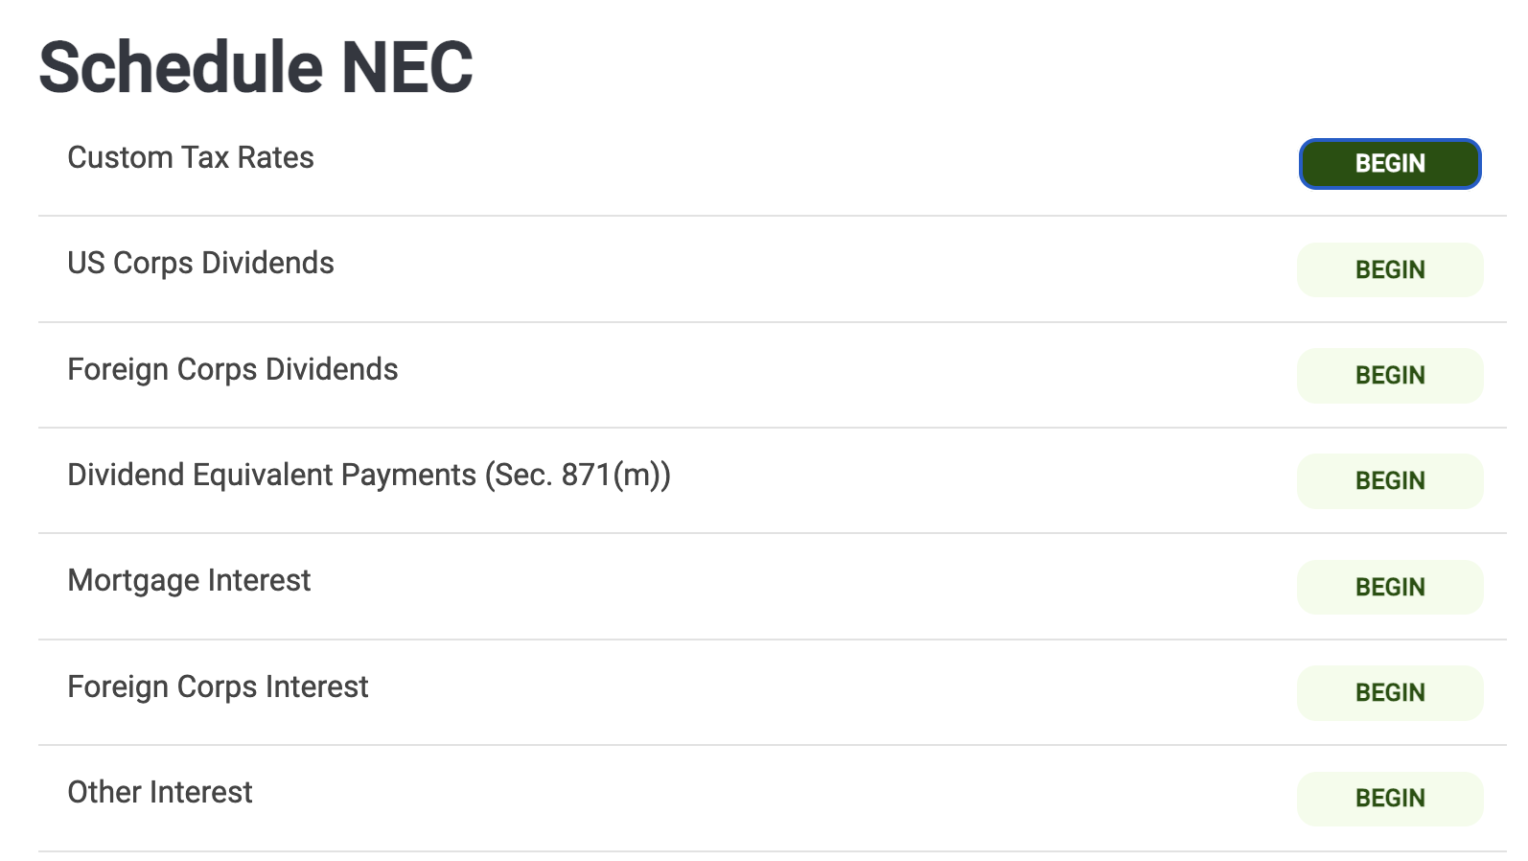
Did you have Dividend Income during the current tax year?
To Report Dividend Income
Click US Corps Dividends

Slide 4
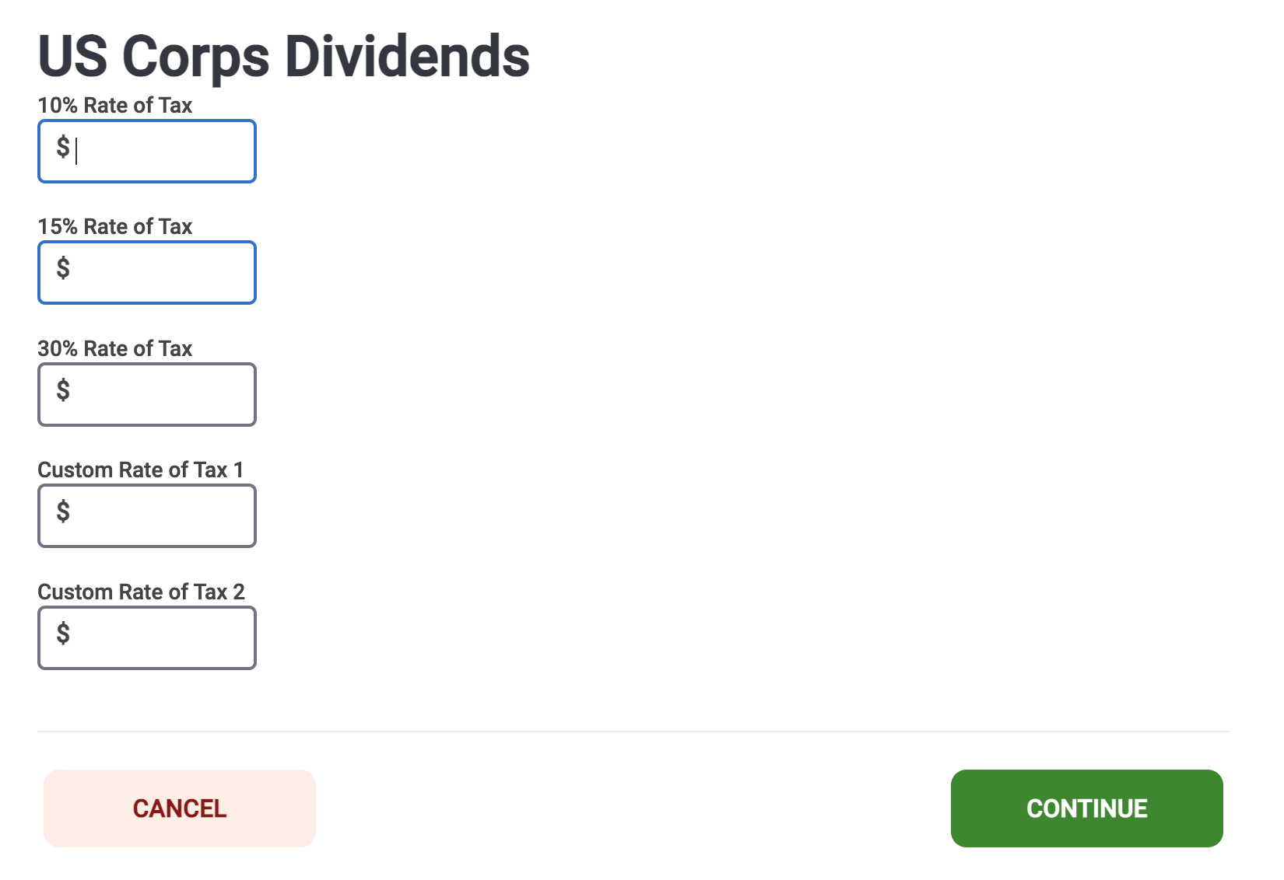
To Determine your Tax Rate, visit Publication 4011
Enter your total amount of dividend income in the correct Rate of Tax box and click Continue.

Slide 5
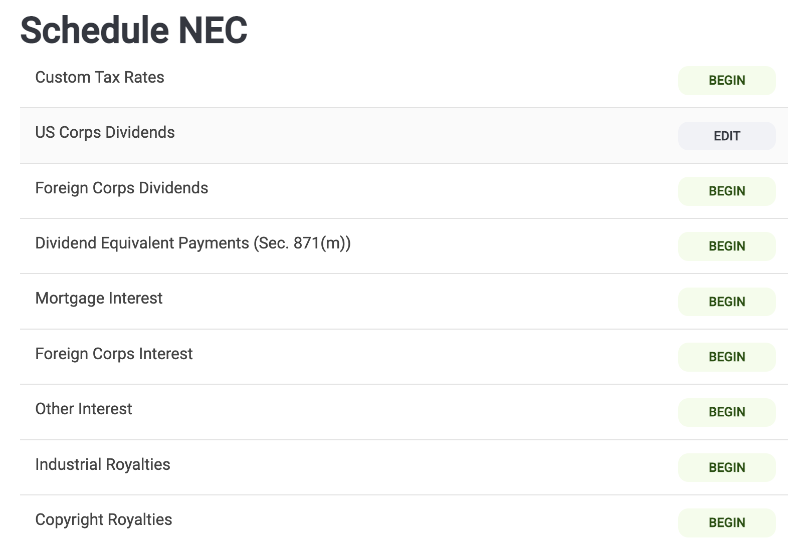
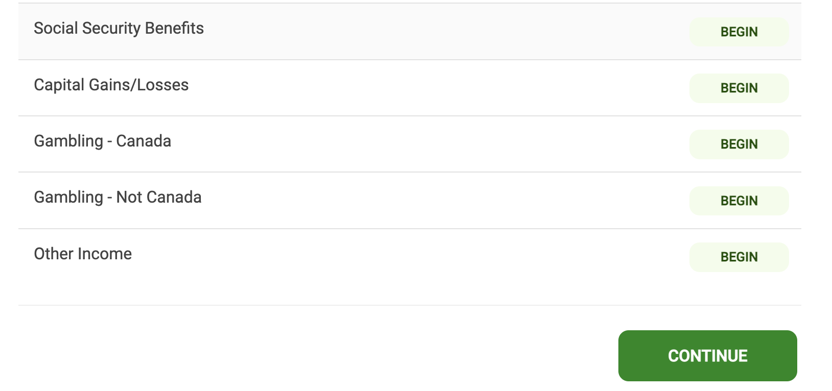
Did you have Capital Gains or Losses in the current tax year?
To Report Capital Gains/Losses…
Click Capital Gains/Losses
Note: You are still in the Other Taxes section and in Schedule NEC.

Slide 6
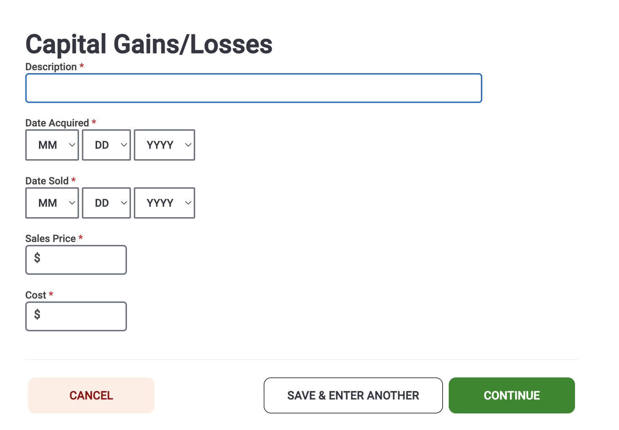
Enter the name of company
Enter the date acquired investment
Enter date sold investment
Enter sales price of investment
Enter cost of investment
Click Continue

Slide 7
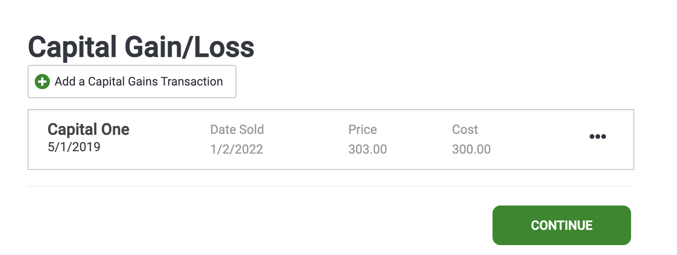
Did you invest in another company?
If so, click on + Add a Capital Gains Transaction option and repeat steps from previous slide
Once you finish entering each capital gain or loss, click Continue

Slide 8
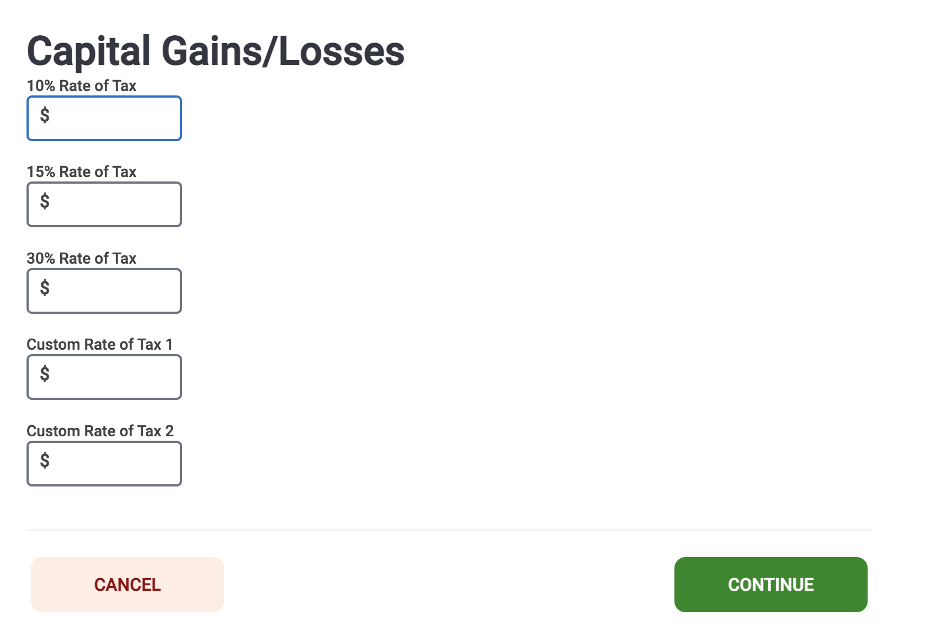
Once you have entered and reported each capital gain or loss, enter the total amount of gain or loss in the correct Rate of Tax box.
Use Publication 4011 to determine your tax rate.
Click Continue

