Slide 1
FORM 1042-S: INTEREST INCOME (Income Code 01 Listed on Form 1042-S Box 1)
The following slides provide instruction regarding how to report interest income you received during the tax year from paying your $4,000 deposit.

Slide 2
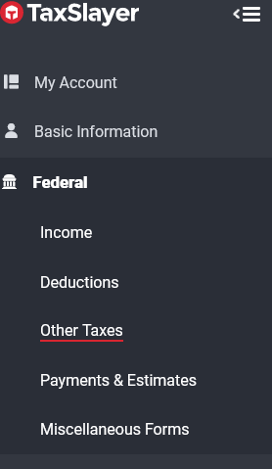
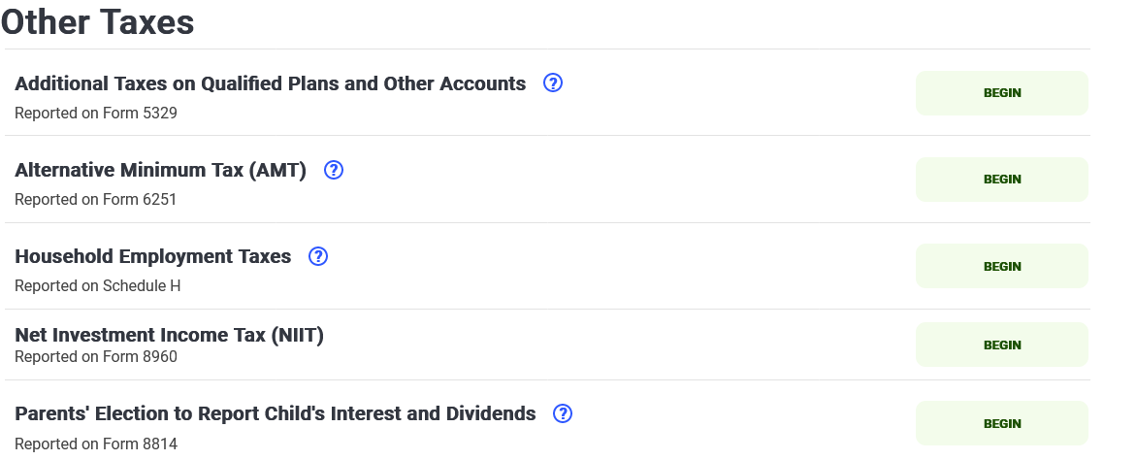
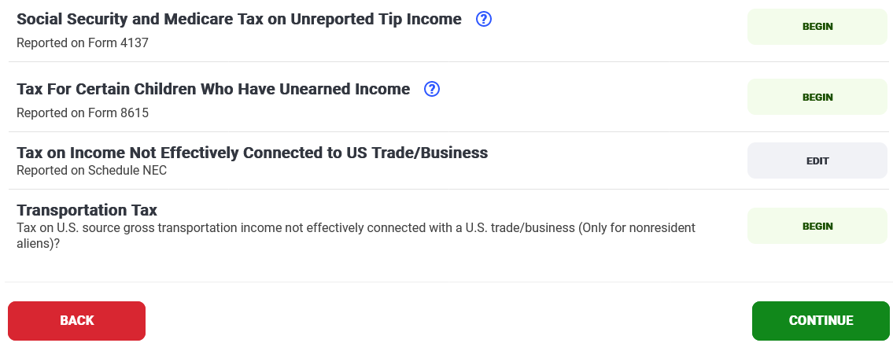
INTEREST INCOME FOR DEPOSIT
To report Form 1042-S for Interest Income from your deposit, you must enter information in TWO places.
First place: Click Other Taxes > Tax on Income Not Effectively Connected to US Trade/Business (Schedule NEC)
See next slide to continue instructions

Slide 3
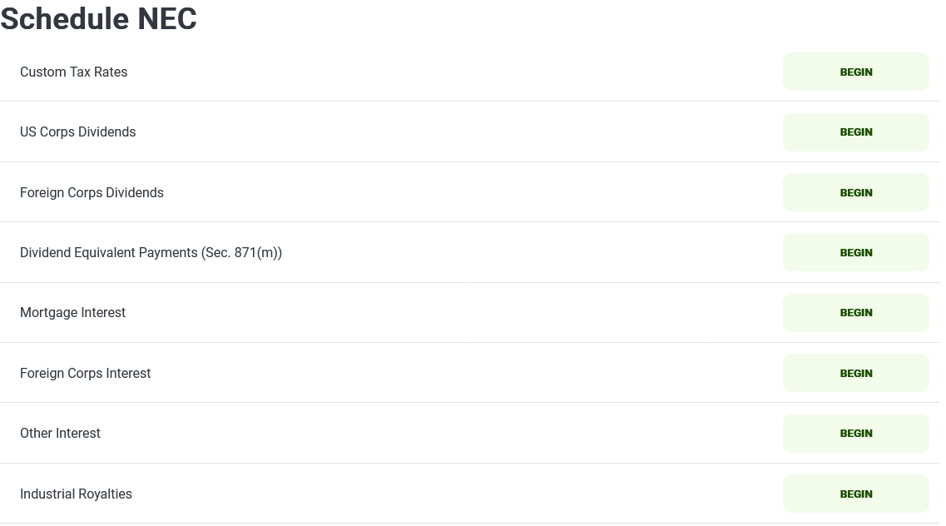
Click Other Interest
See next slide for more instructions.

Slide 4
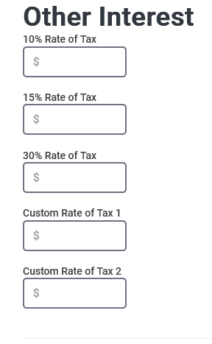
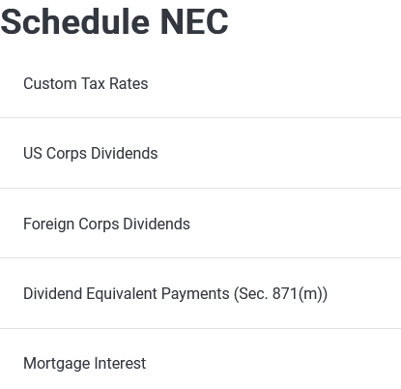
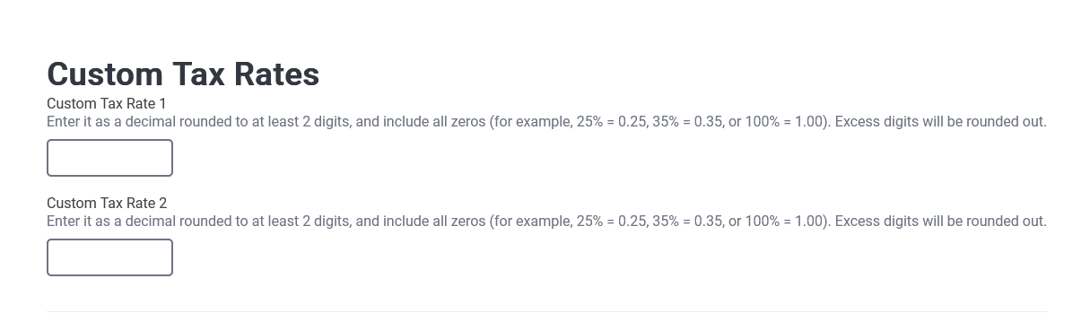
Enter gross income found in Box 2 on Form 1042-S in the corresponding Rate of Tax box in TaxSlayer
To determine corresponding Rate of Tax, view Rate of Tax found in Box 3b on Form 1042-S
IMPORTANT
If your Form 1042-S indicates your tax rate is 0%, enter your gross income amount in the box titled, Custom Rate of Tax 1.
Click Continue >Custom Tax Rates & Enter 0.00 in the box titled Custom Tax Rate 1

Slide 5
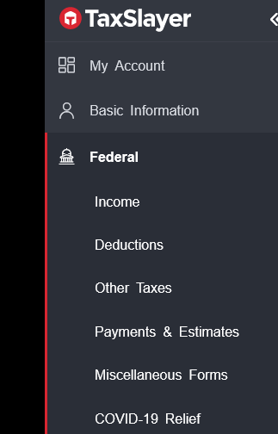
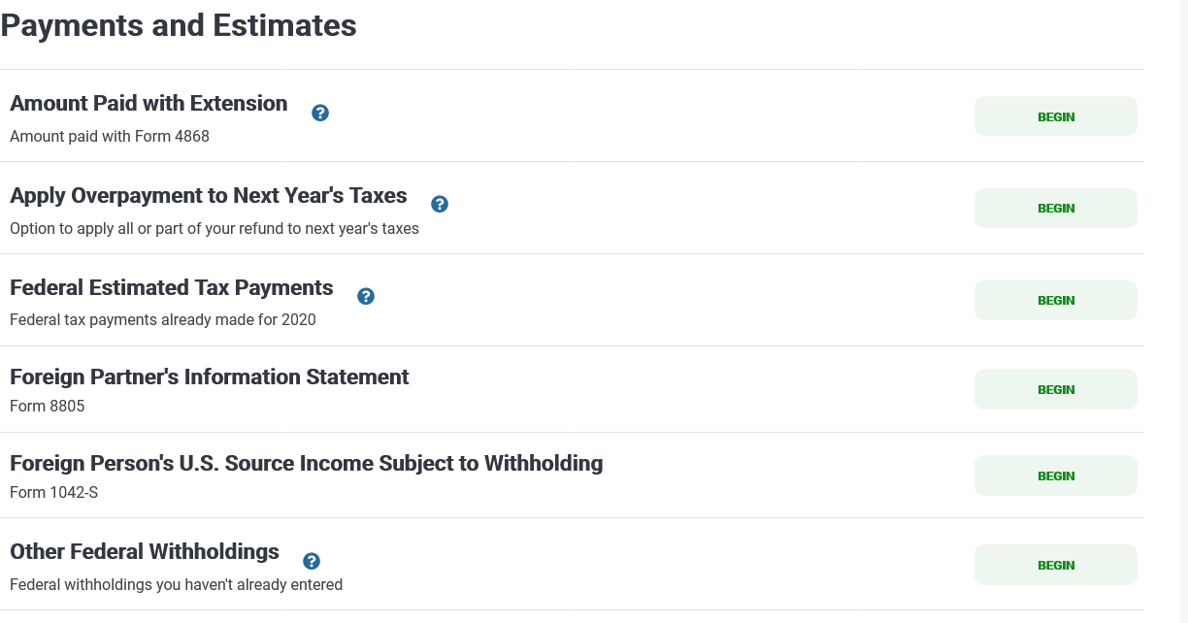
Second place:
In addition to entering the gross income, you must enter the rest of the Form 1042-S information in the Form 1042-S section.
  Click Payments & Estimates
  Click Foreign Person’s U.S. Source Income Subject to Withholding (Form 1042-S)

Slide 6
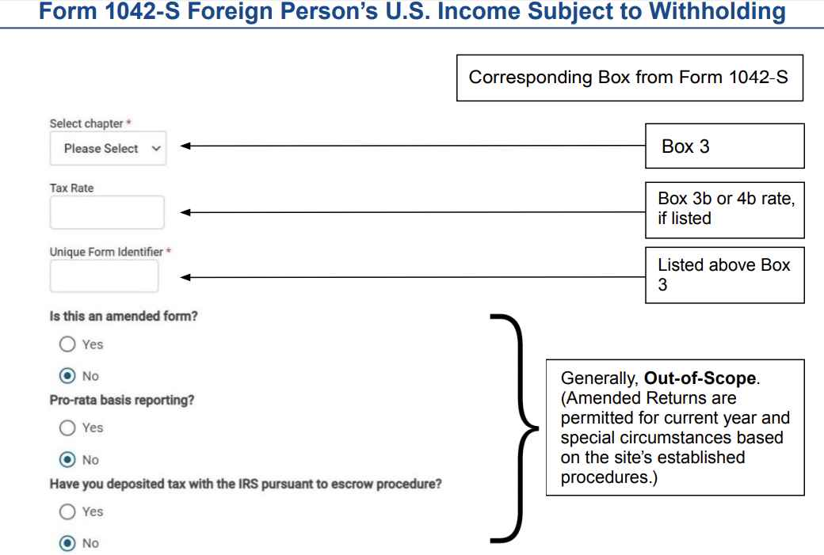
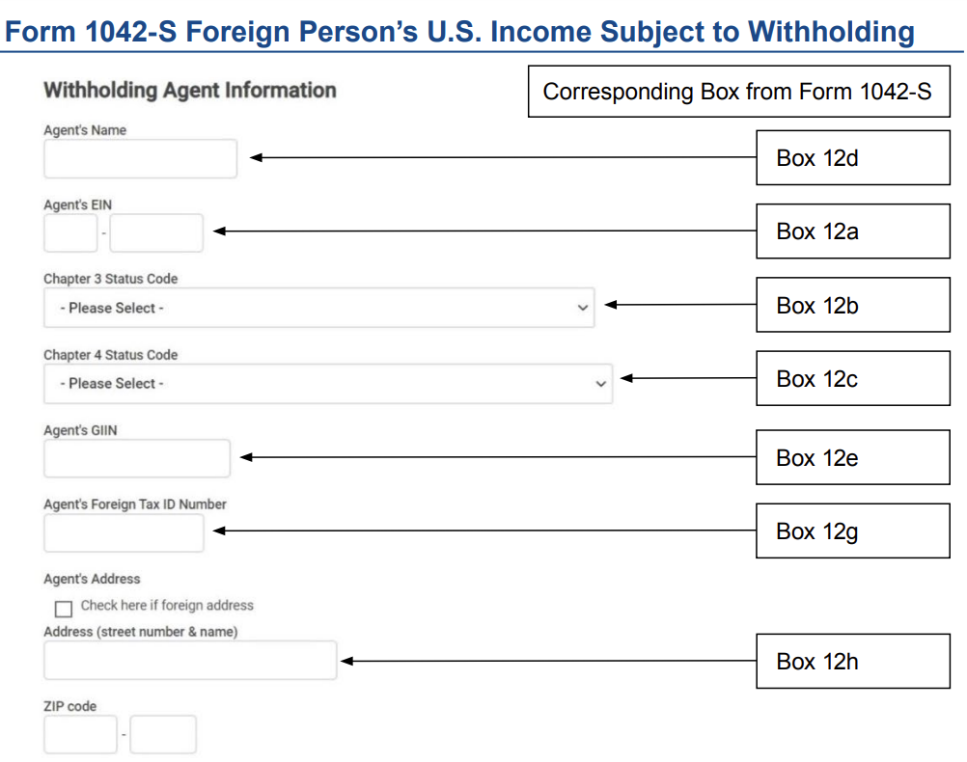
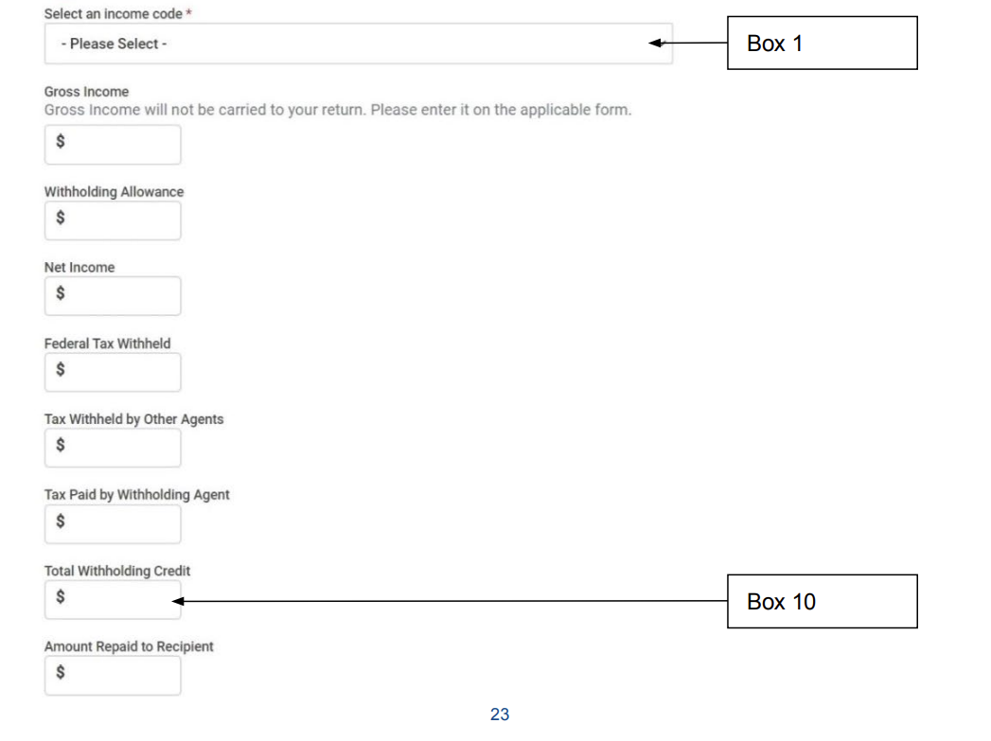
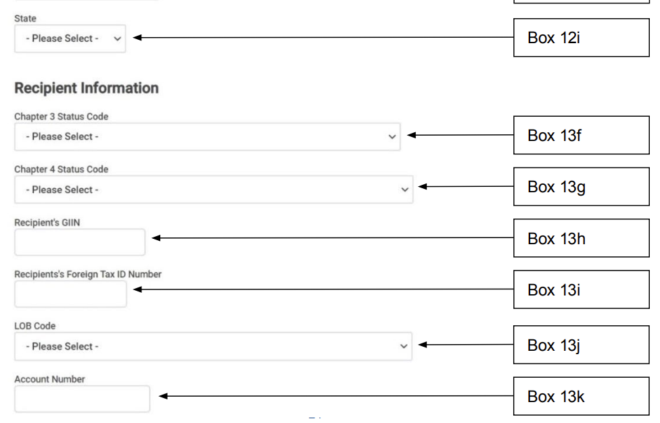
Chapter 3 Status Code *
Box 3a
If TaxSlayer Requests this Box
Box 2
Box 5
Box 6
Box 7a
Box 8
Box 11

Slide 7
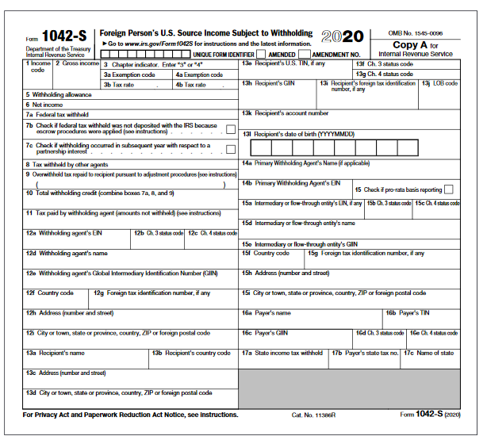
Select chapter
Please Select
Tax Rate
Chapter 3 Status Code
(if TaxSlayer Requests this box)

