Slide 1
HOW TO SELF-FILE
NONRESIDENT TAXES

Slide 2
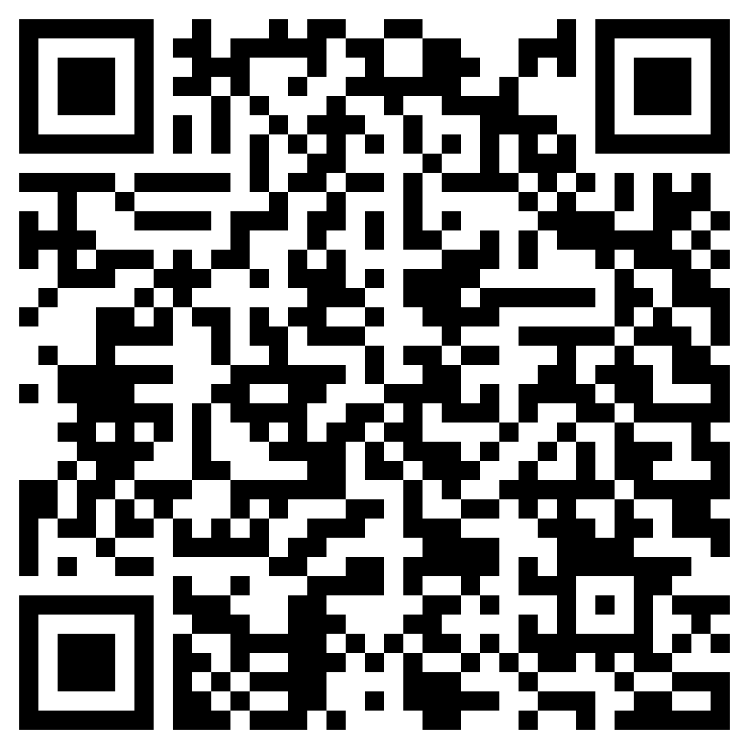
Take Survey to Determine Residency Status

Slide 3
Warning: We CANNOT Help Those Who….
  1. Have a JOINT Marketplace Insurance plan.
            This is also called Select Health, Obamacare, Affordable Care Act.
            Please make an appointment with the Low Income Taxpayer Clinic 801-201-8001
  2. Did not receive any type of income in 2024
            We will review the types of income you must report in the next slide…

Slide 4
Type of Income in 2024
In 2024, did you …..
  Work
  Pay the $4,000 Deposit before Winter 2024
  Receive a scholarship that exceeded tuition, books, and fees?
  Have Marketplace place insurance? NOTE, we can only help those who signed up for an individual plan.
  Have capital gains and dividend income?
  Have any other type of income?
  If the above applies to you, we can help you—you are in the right place!

Slide 5
Are you a Nonresident or Resident?
Determine your residency status for tax purposes HERE.
  Nonresidents:
        If you are a non-resident for tax purposes, Congratulations! You are in right place to file your tax.
  Residents:
        If you are a resident for tax purposes, you have the following resources to help you file resident tax forms:
            Visit the Marriott School VITA lab: https://vita.byu.edu
            The IRS offers free services or websites to file resident tax forms. You may check that out here:
                https://www.irs.gov/filing/free-file-do-your-federal-taxes-for-free
                https://myfreetaxes.com/
            Use other online websites to help you file your taxes (FreeTaxUSA, TurboTax, etc.). Be aware that these online tax websites require payment.

Slide 6
FORM 13614NR
Be sure you have Form 13614NR COMPLETELY filled out before filling out your tax forms.

Slide 7
WARNING!! WARNING!! WARNING!!
DO NOT SUBMIT YOUR TAXES TODAY!!!
Are you an undergraduate student who paid the $4,000 deposit and is gaining interest on the deposit?
Are you an undergraduate or graduate student who received a scholarship or stipend that exceeded tuition, books, and fees?
If you answered yes to either of these questions, WAIT to receive Forms 1042-S so you may report that form in your tax forms. DO NOT submit your tax forms today if you have NOT received Forms 1042-S yet.

Slide 8
Taxpayer Login Procedures
Click on the link for TaxSlayer FSA to complete a NONRESIDENT tax return, Form 1040NR
https://www.taxslayer.com/v.aspx?rdr=/vitafsa&source=TSUSATY2024&sidn=34064129
You may exit the program and return to complete the return. You will need to click on the link to return and sign in to complete the return.

Slide 9
TaxSlayer Welcome Page
Click CONTINUE

Slide 10
Create an Account
Click on Create account
You will need to type:
  Email address
  User name
  Password
  Cell phone number
TIP: You can enter your email if you do not have a cell phone number
Click CREATE ACCOUNT

Slide 11
Verification Page
Follow the instructions on the reCAPTCHA page
Click VERIFY

Slide 12
Check Your Phone
If you entered a cell phone number on the Create your
account page, TaxSlayer FSA displays the Check your phone
page.
Type the 6-digit code from the text into the appropriate box.
Click VERIFY
TIP: You can verify the code by email if you did not add a cell
Phone number when creating your account.

Slide 13
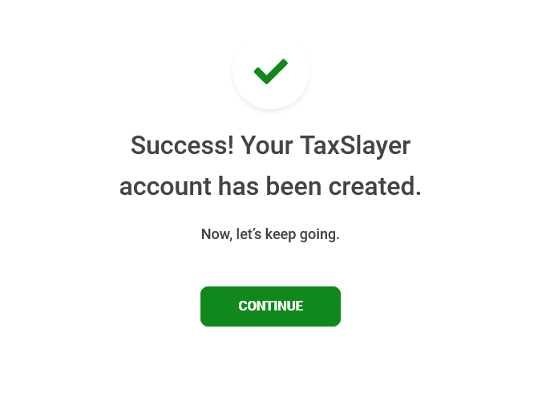
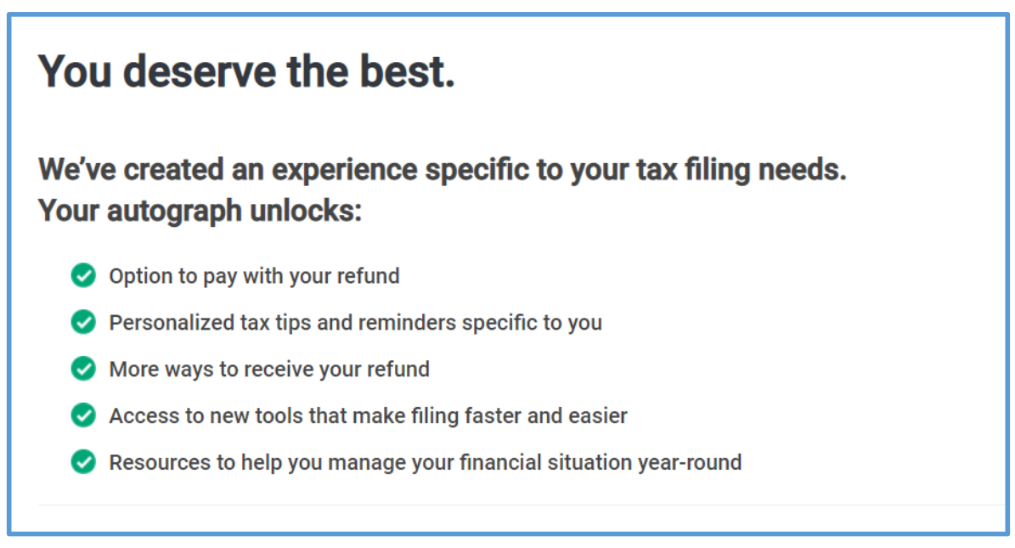
Click CONTINUE
Read the information on the page and click CONTINUE.

Slide 14
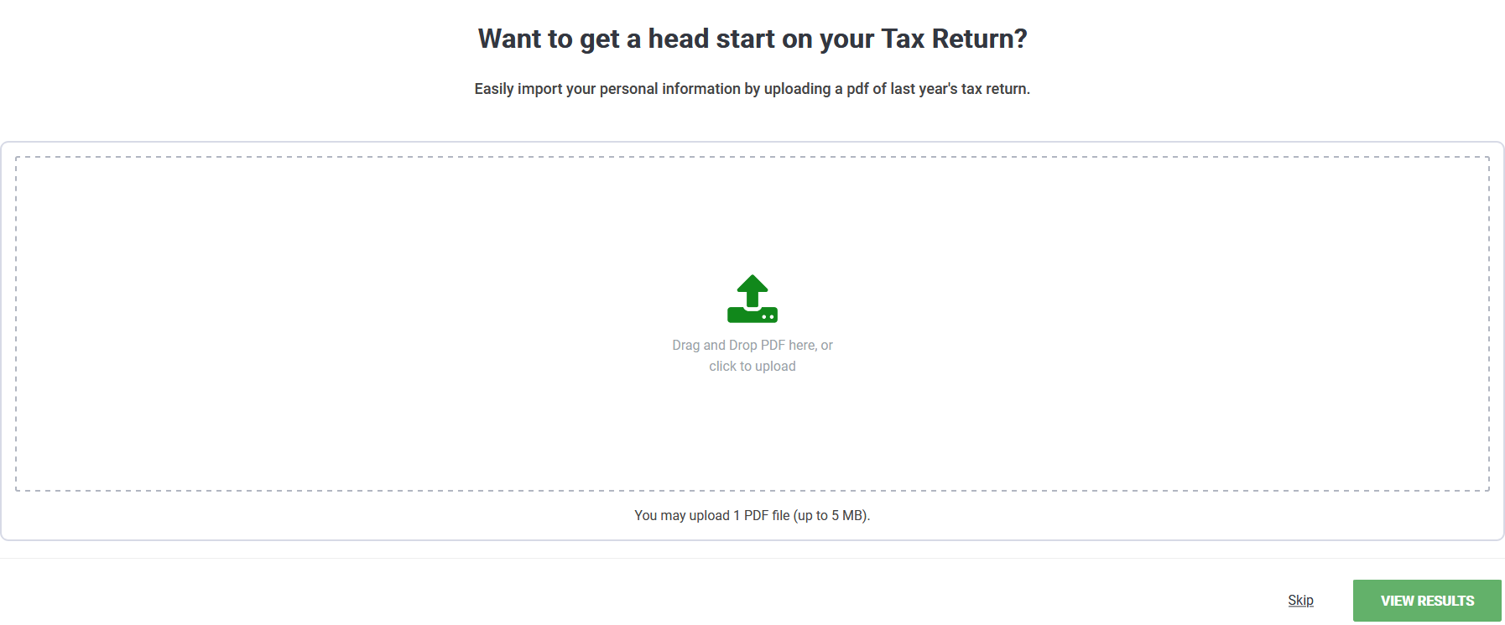
If you have a PDF file of your 2023 tax return, you may upload it here and click VIEW RESULTS.
If not, click Skip.
  Note: it is not necessary to upload your 2023 tax return.

Slide 15
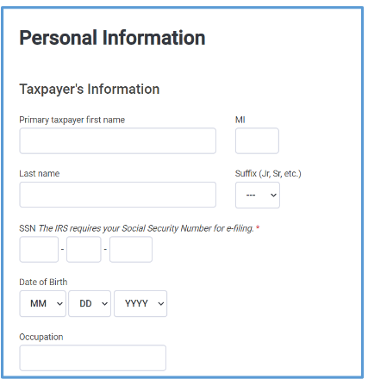
Preparing the Return
Do one of the following:
If you uploaded a PDF of the previous year’s return, verify your personal information and click CONTINUE.
OR
2. Type your personal information and click CONTINUE.
Type your name the way it is listed on your social security card. It must match exactly.
If you are a student, type Student for your occupation.

Slide 16
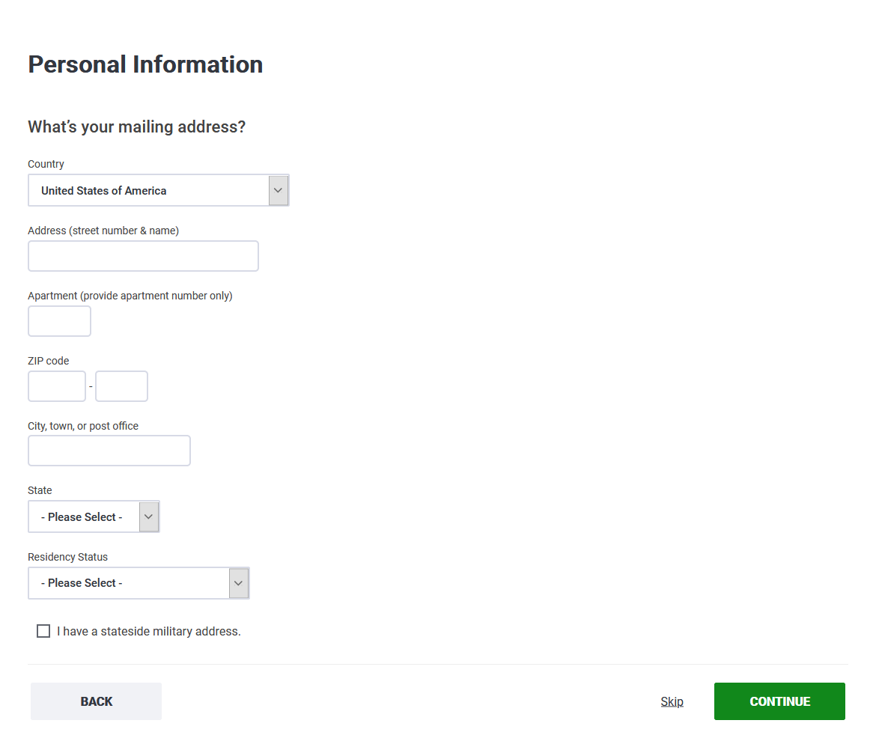
Enter your U.S. address. Note: if the IRS needs to contact you, this is the address they will use to send you mail.
Residency Status: choose one of the following options:
  Full-Year Resident of This State: You are a Resident of Utah if you are domiciled in Utah for the entire year, regardless of temporary absences OR you maintained permanent living quarters AND spent more than 183 days in Utah during the tax year.
  Full-Year Resident of Another State. You will need to look up the definition of full-year resident of the state you lived in last year.
  Part-Year State Resident: You are a Part Year Resident of Utah if you moved into or out of Utah during the tax year. Do not include temporary absences.

Slide 17
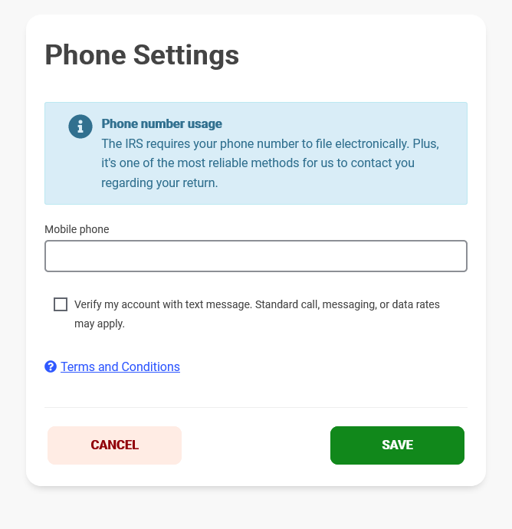
Enter your phone in the space provided. TaxSlayer may use your phone number to verify your information.

Slide 18
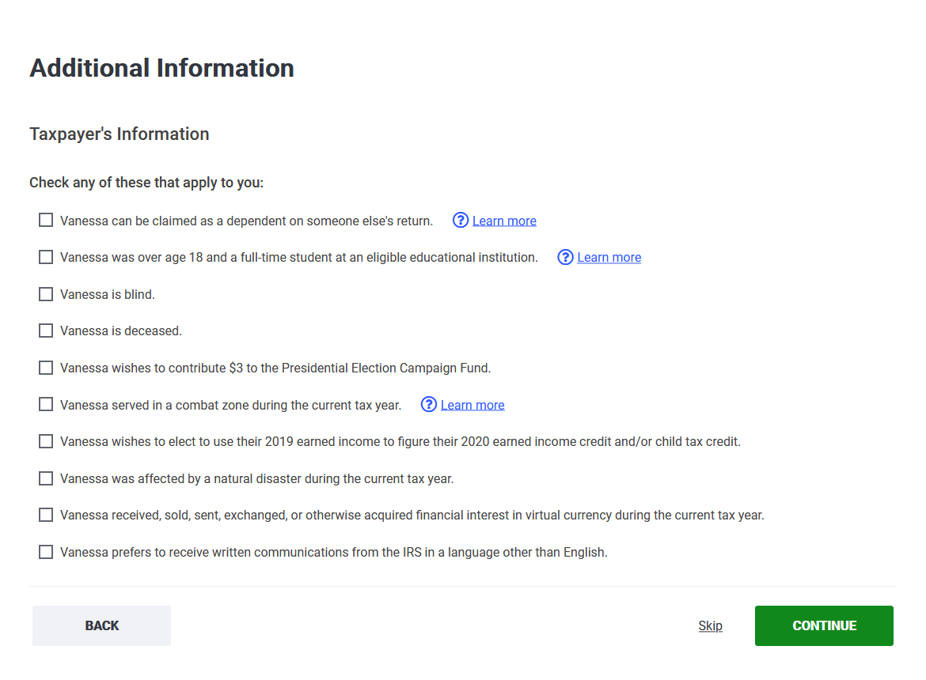
Mark the boxes that apply to you

Slide 19
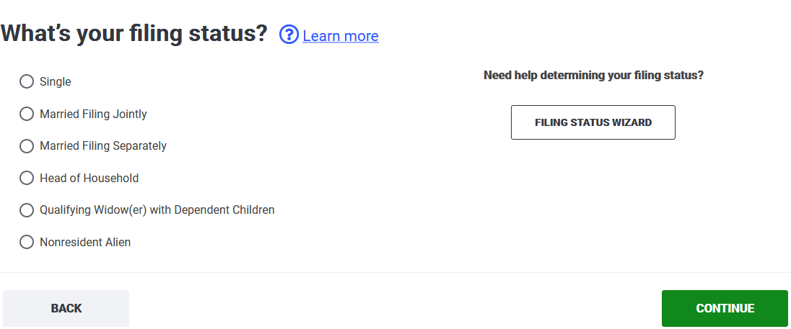
Mark Nonresident.
Please read below for the definition of a nonresident.
Nonresidents:
A student on F-1 or J-1 visa (OR dependents of students on F-2 or J-2 visas) who..
Is studying (or on OPT) and has been in the U.S. for any part of 5 years or less on this visa
OR
A J Scholar on J-1 visa (OR dependents of a scholar on J-2 visa) who..
Is a professor, scholar, researcher and has been in the U.S. for any part of 2 years or less
Note:
When counting years, count up to the tax year (2024).
One day in the country counts as that entire year.
The years do not need to be consecutive (i.e. before mission and after).
If you have been in the U.S. for 6 years or more on a student visa or 3 years or more on a scholar visa, please go here to determine if you are truly a resident.

Slide 20
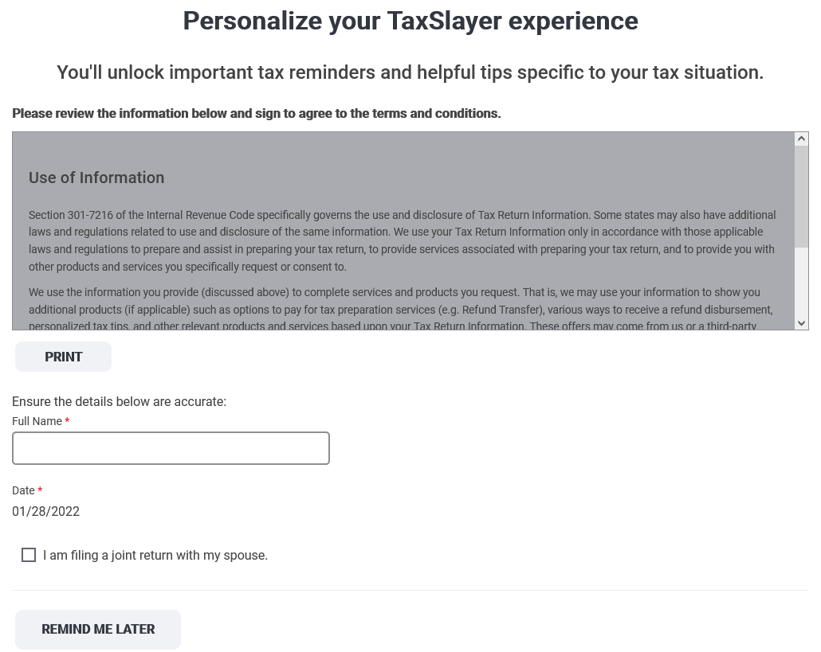
Read the information on the page and type your full name in the appropriate boxes.
Note: Nonresidents cannot file jointly with their spouse. If you are married, do not mark the box saying that you will be filing with your spouse.
Click CONTINUE.

Slide 21
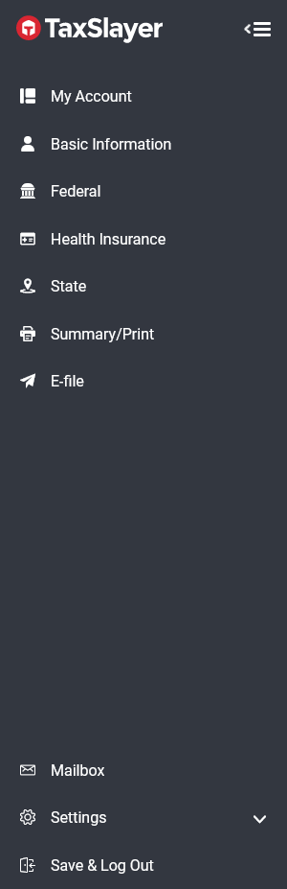
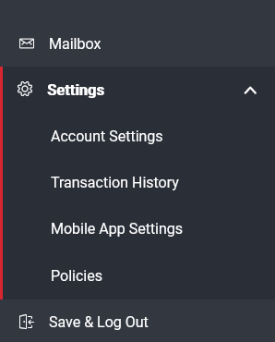
Did you make an error and need to restart?
If you did not click NONRESIDENT, in the previous screen,
Click SETTINGS
Click TRANSACTION HISTORY….
Remember that these slides describe how to file as a NONRESIDENT. If you are considered a resident for tax purposes, please schedule an appointment with either:
Low Income Taxpayer Clinic (801-210-8001)
Or Marriot School VITA (https://vita.byu.edu)

Slide 22
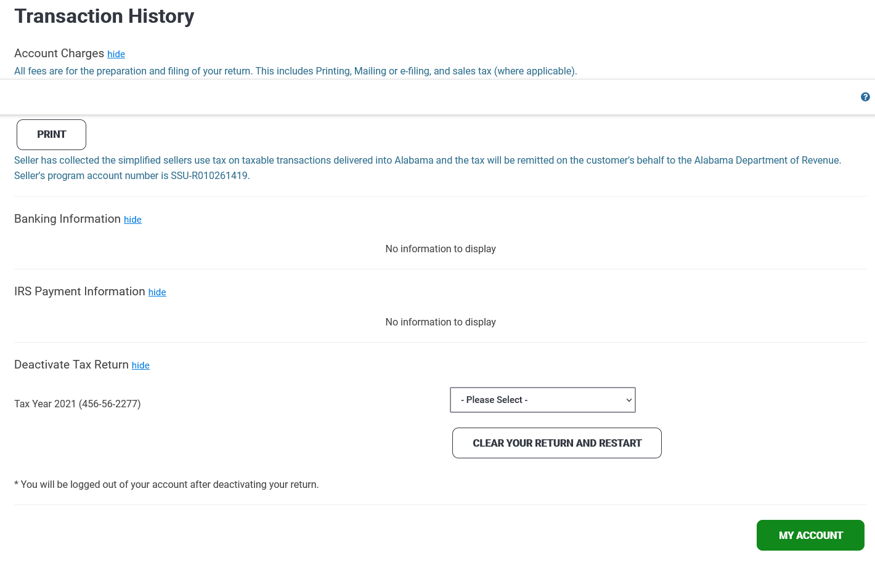
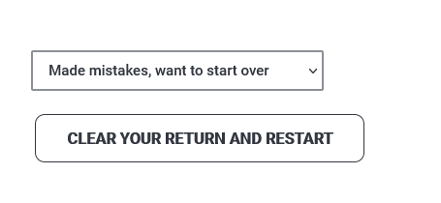
Choose Made mistakes, want to start over
Click CLEAR YOUR RETURN AND RESTART

Slide 23
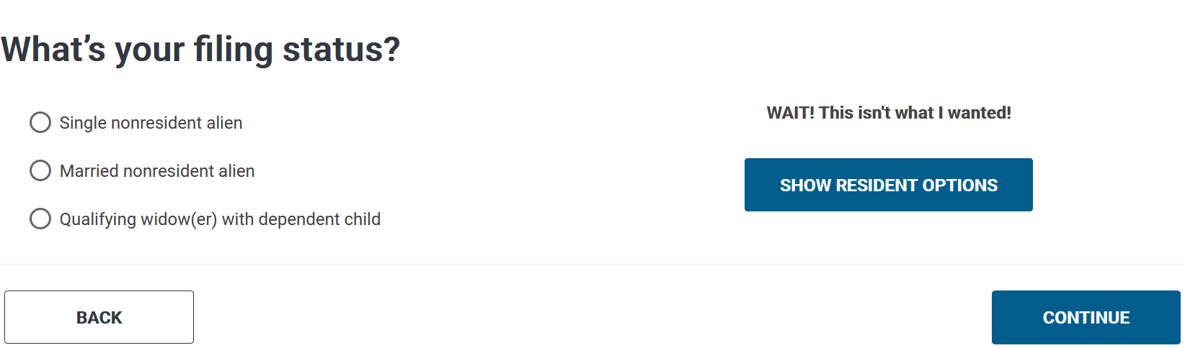
Married nonresident: TaxSlayer requires that you enter spousal information (name and SSN or ITIN) in order to complete and e-file your state return. If you would like to e-file your federal return only, you may continue following these instructions and elect to skip the state return to allow for TaxSalyer to e-file your federal return as a Married Nonresident. If you wish to file both the federal and state returns through TaxSlayer, you must select Single. To file the state return separately, you may go here.
Mark the filing status that corresponds to you.
Generally, nonresident aliens must select either the Single or the Married nonresident alien status.
Nonresidents cannot file jointly with their spouse. Each individual must file their own tax return.
Only residents of Canada, Mexico, Republic of Korea (S. Korea), and India may qualify for the Qualifying Widow(er) with Dependent Child(ren) status, if applicable.)

Slide 24
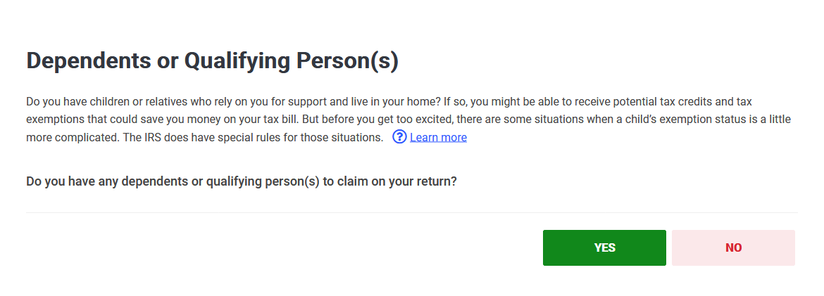
Only residents of Canada, Mexico, South Korea, and India may be able to claim their children as dependents.
Note: Everyone claimed on the return must have either a social security number (SSN) or a valid Individual Taxpayer Identification Number (ITIN)

Slide 25
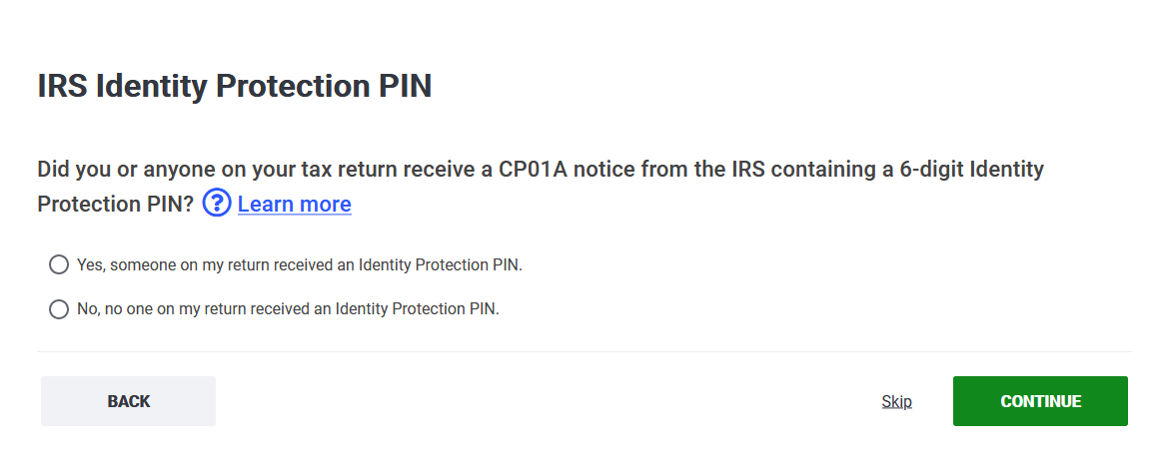
If you have been notified by the IRS that you, your spouse, or your dependent have been a victim of identity theft, they will issue an IP PIN or identity theft pin. If this is the case, mark YES.

Slide 26
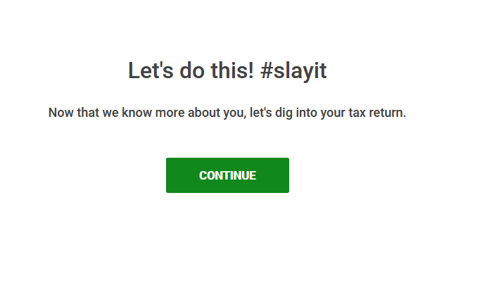

Slide 27
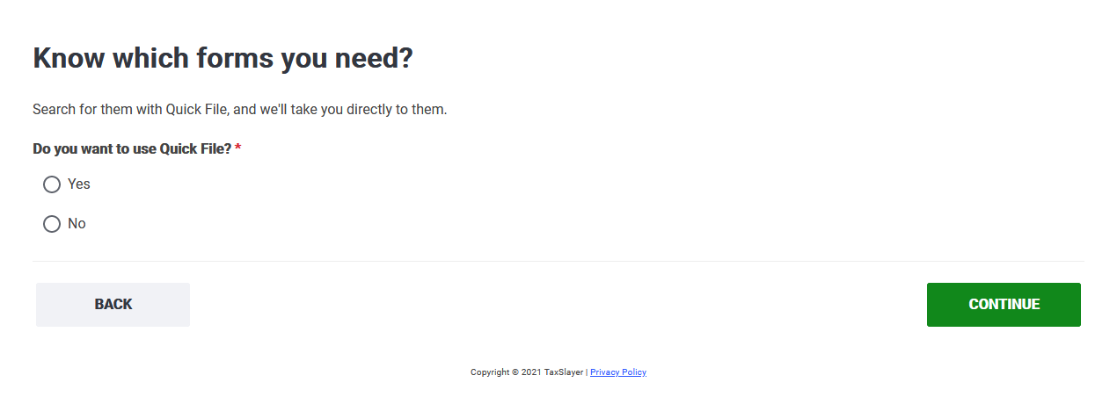
If you know the forms you must report, click YES.
We recommend that you follow these instructions though as you navigate through this software.

Slide 28
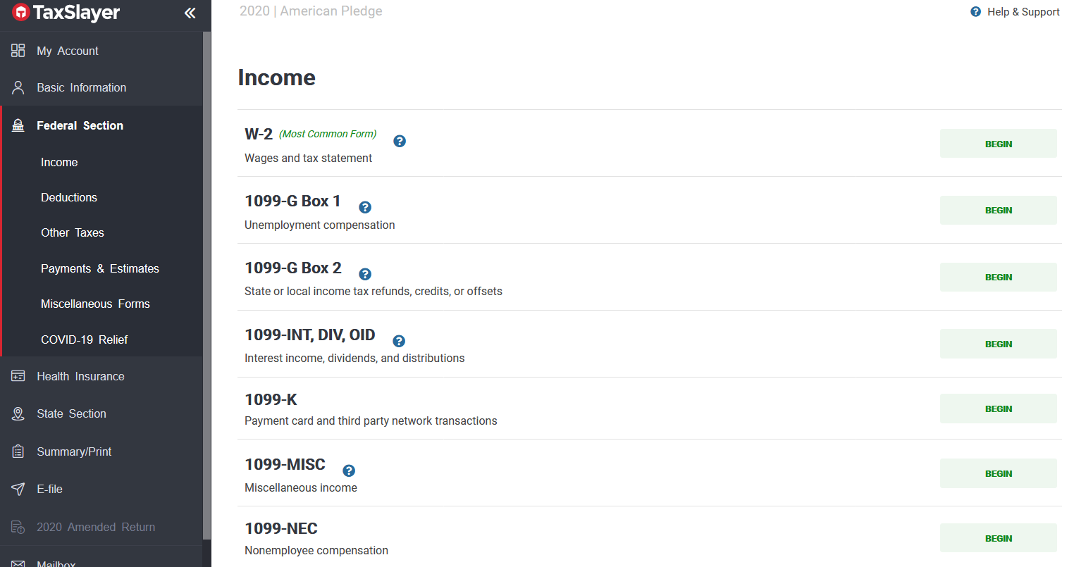
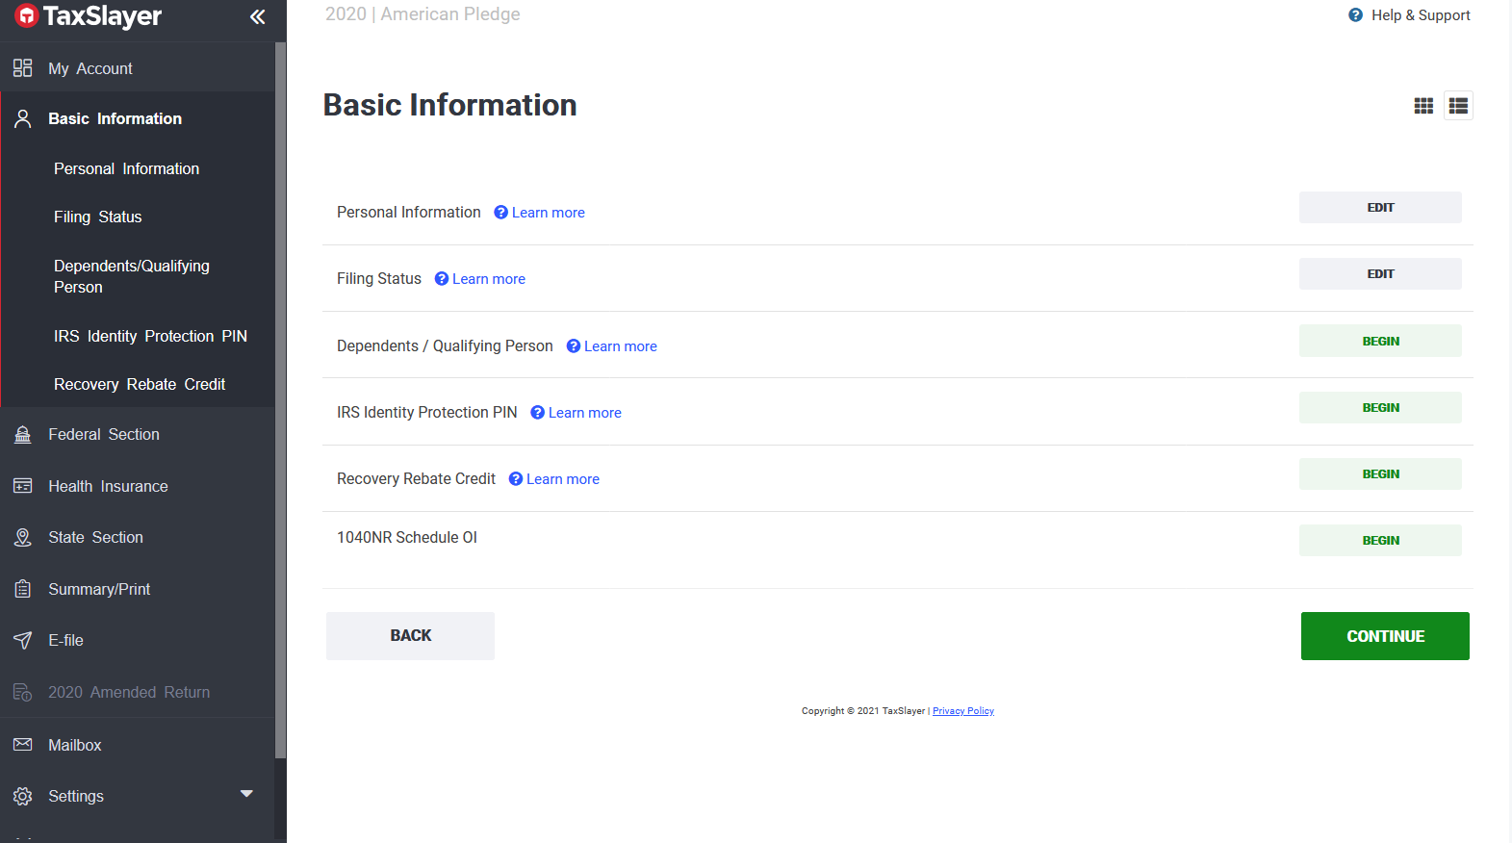
Before you move on to the Federal Section….
Click Basic Information
And click 1040NR Schedule OI

Slide 29
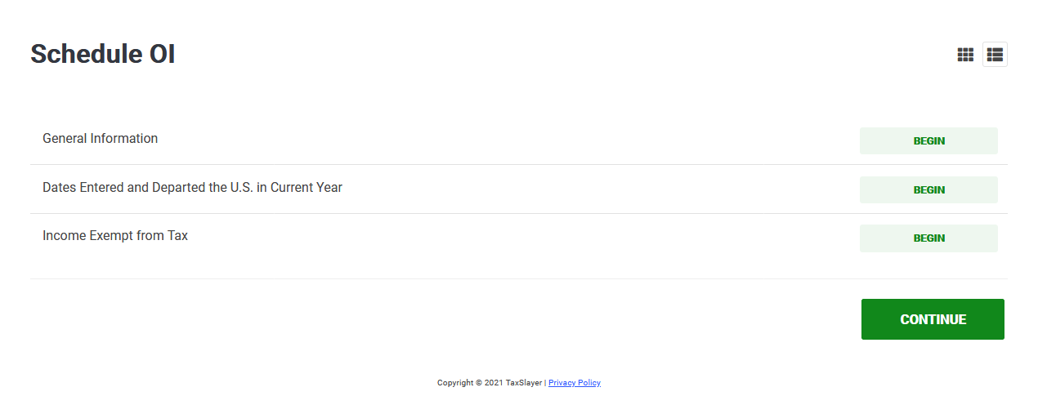
Click General Information
Click Continue

Slide 30
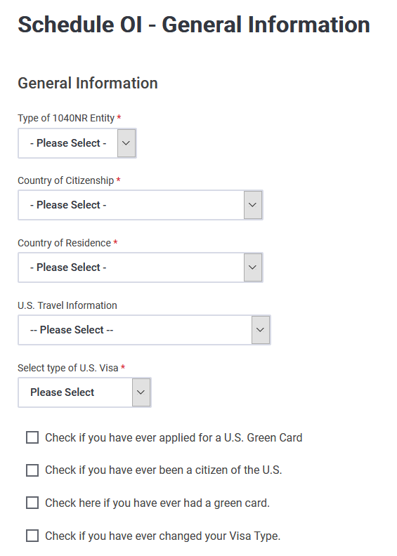
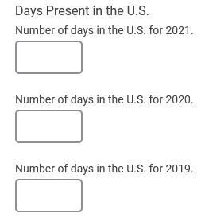
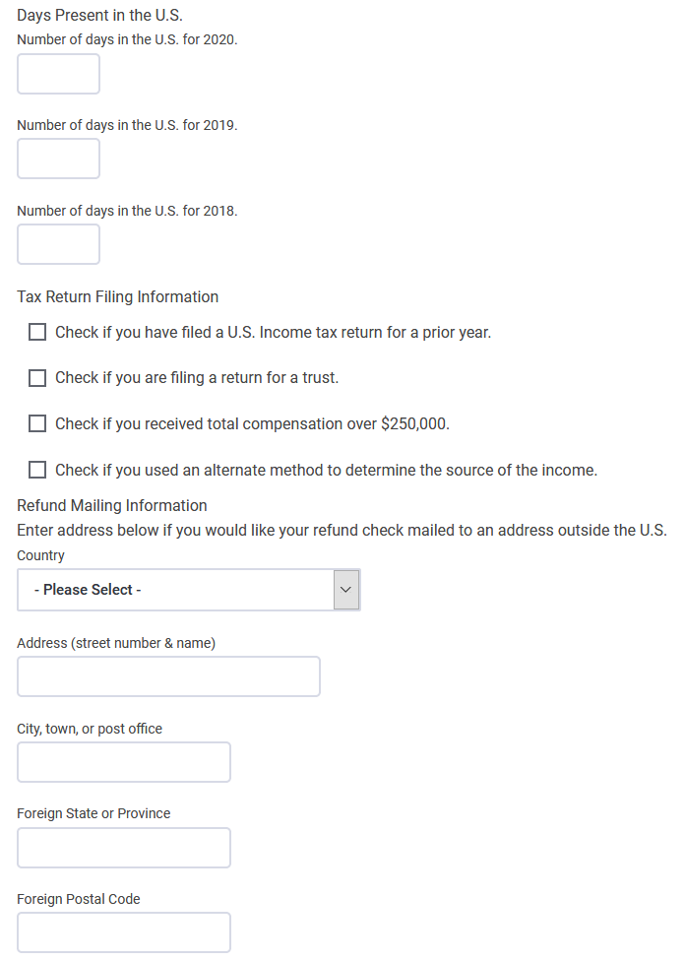
Enter number of days you were present in the U.S. each year (2024, 2023, 2022)
Select INDIVIDUAL
Choose the options that correspond to you
Check boxes that apply to you
Leave this blank
Choose NONIMMIGRANT
F & J visas are considered nonimmigrant visas
If you are eligible for a refund and would like your refund mailed to an address outside the U.S., fill out this section.
Check boxes that apply to you

Slide 31
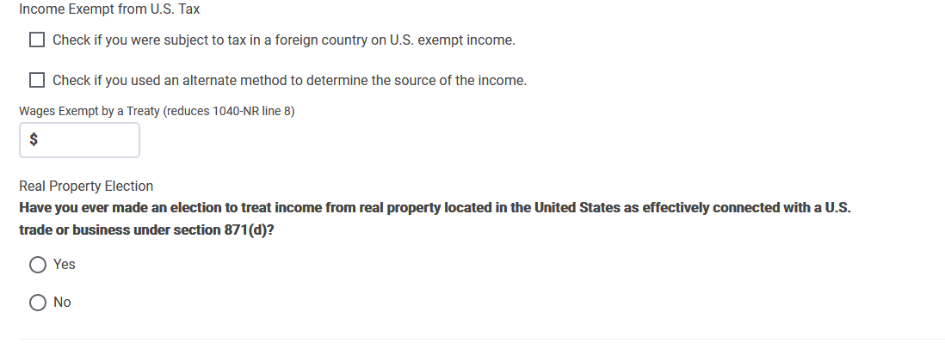
Schedule OI (continued)
Check boxes that apply to you
If you are a resident of a country that holds a treaty with the U.S., enter the amount of your treaty here. If your earned income was less than your treaty amount, enter your earned income amount instead of treaty amount. For example, if you earned $4,000 in 2024 and your treaty amount is for $5,000 enter $4,000. Please view Publication 4011 to view a list of countries that have a treaty with the US.
If you are a SCHOLAR from India, you will have a treaty and you will need to enter your treaty amount in this section.
Click YES if this applies to you
If you are a STUDENT from India, DO NOT enter your treaty amount here. You will need to take the Standard Deduction by going to Deductions>Itemized Deductions>Use Standard or Itemized Deduction>Take Standard Deduction
If you are a resident of Canada and earned $10,000 or less in 2024, you are eligible to claim your treaty. But if you earned more than $10,000, you are no longer eligible to claim your treaty.
Click CONTINUE

Slide 32
Click CONTINUE
If you departed and entered the U.S. in 2024, click Dates Entered and Departed the U.S. in Current Year.

Slide 33
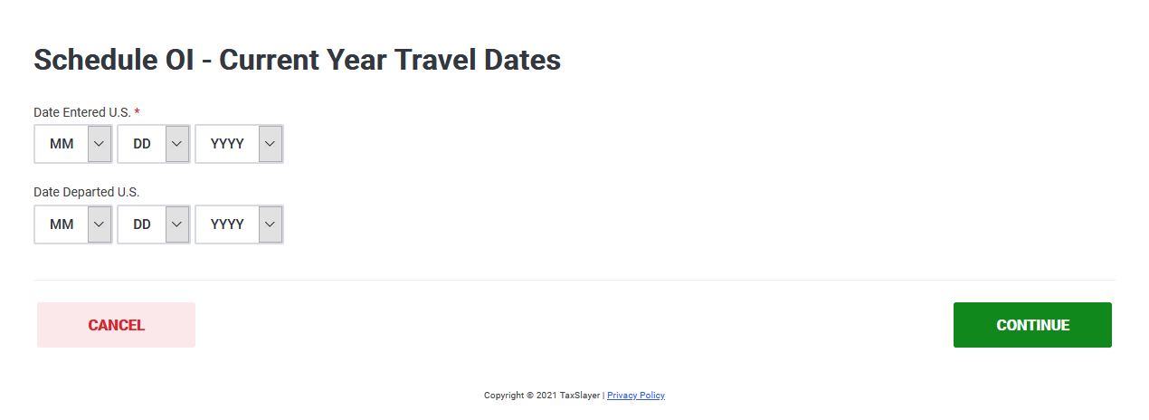
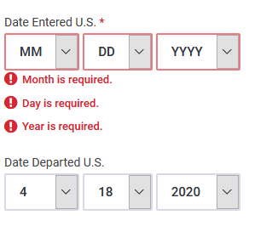
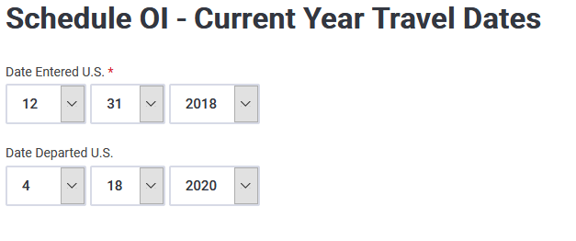
Example
Enter date you entered the U.S. in 2024. Note: Date Entered is a required field.
If you did not enter the U.S. in 2024 before you departed, we recommend that you enter the date you first entered the U.S. on your current visa.
Click CONTINUE

Slide 34
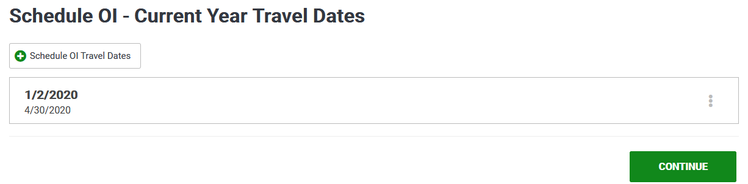
If you have additional travel dates, click +Schedule OI Travel Dates to enter additional dates.
Click CONTINUE.

Slide 35
Click CONTINUE
If you are a resident of a country that holds a tax treaty with the U.S., click Income Exempt from Tax.
  If you are from Canada, please view Publication 4011 to read your treaty or consult with a VITA volunteer.
  If you are a resident of India, please consult with a VITA volunteer.

Slide 36
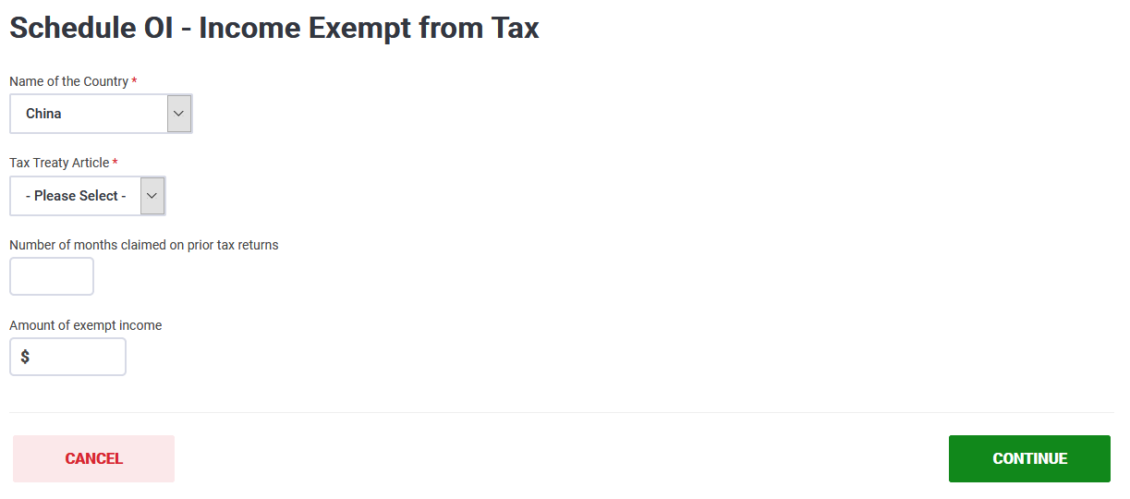
Click CONTINUE
Select country of which you are a resident.
Select Tax Treaty Article. You can find the treaty article in Publication 4011, or you may consult with a VITA volunteer.
Have you claimed this treaty in prior years? If so, indicate how many months you have claimed it.
Enter amount of treaty you are claiming. Remember, if your earned income is less than the treaty amount, report your earned income. You may find treaty information in Pub. 4011.

Slide 37
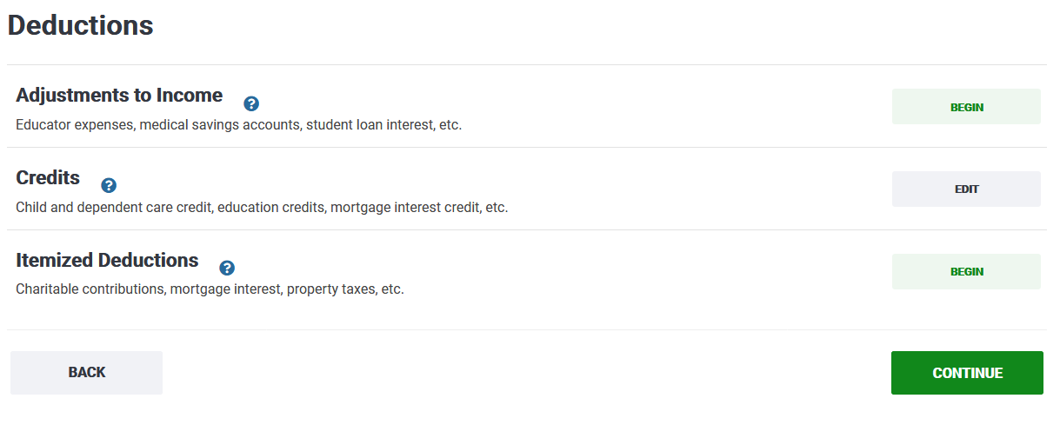
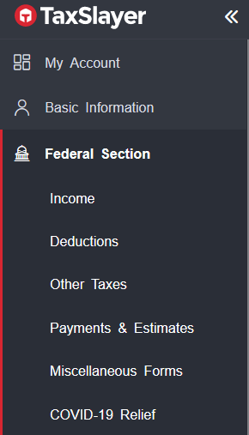
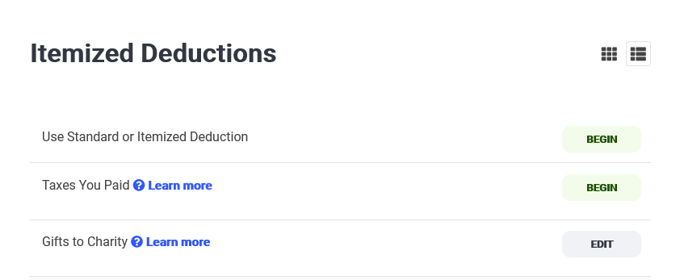
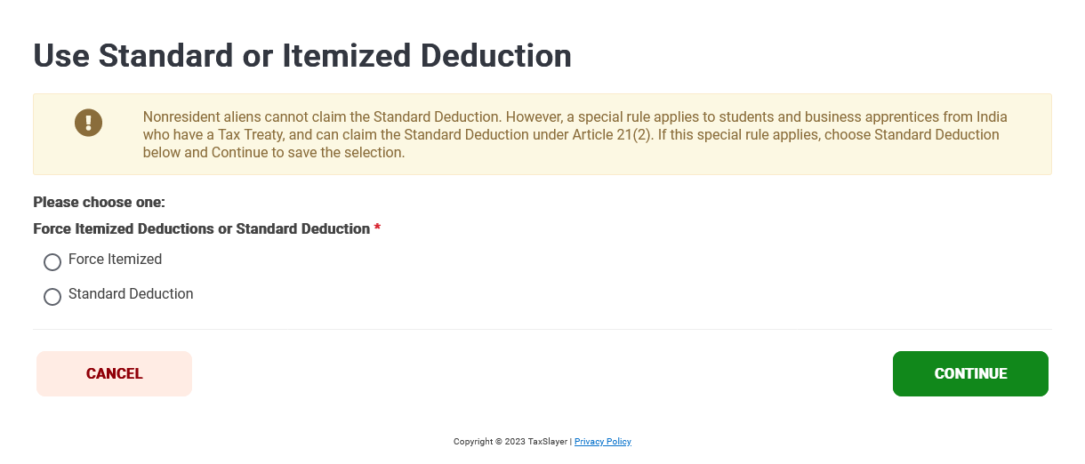
Are you a STUDENT from India?
If so, you will need to take the standard deduction.
Click….
  Deductions
  Itemized Deductions
  Use Standard or Itemized Deduction
  Check Standard Deduction

Slide 38
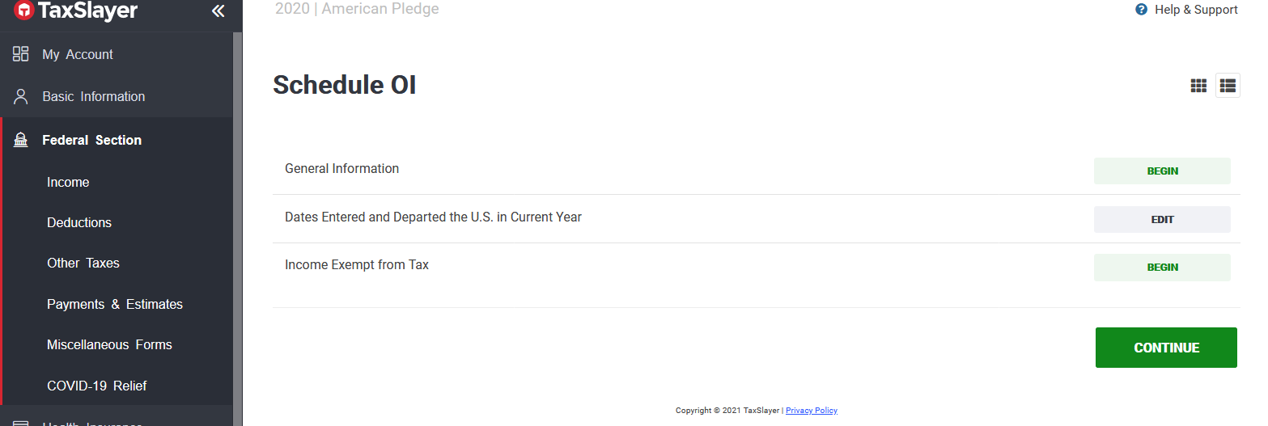
Click Federal Section to report income.

Slide 39
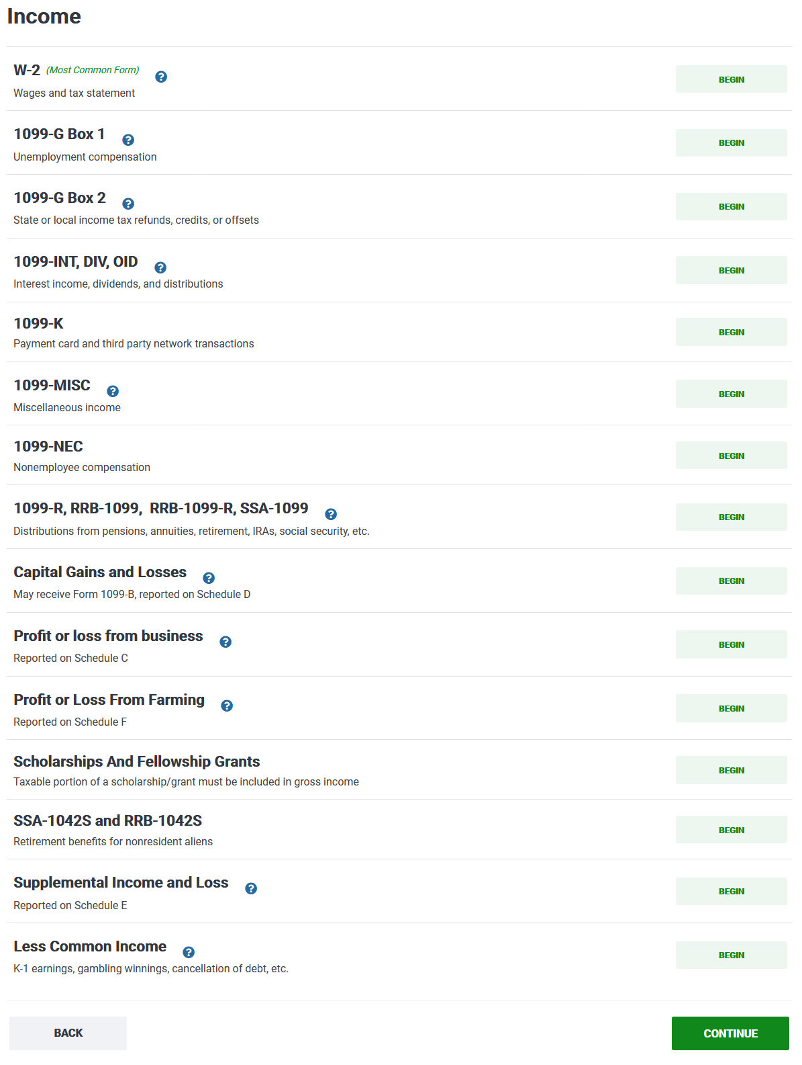
This page contains forms you may have received that reflects income.
Click on the form you received.
The most common form students or scholars receive is Form W2, which reports wages from your employer.

Slide 40
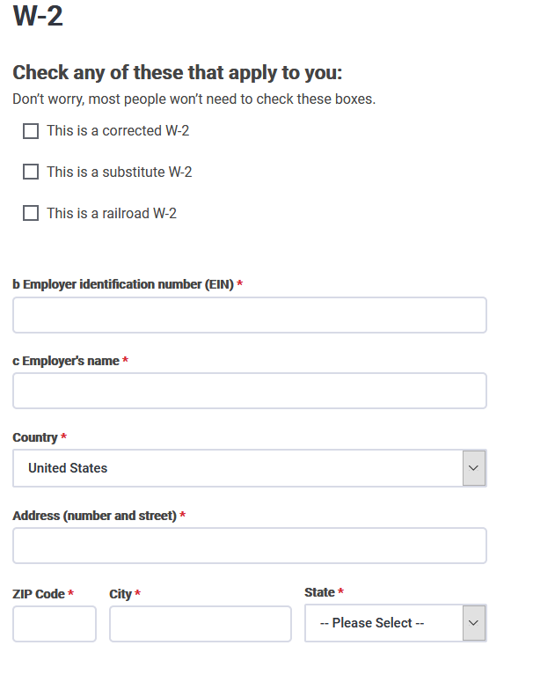
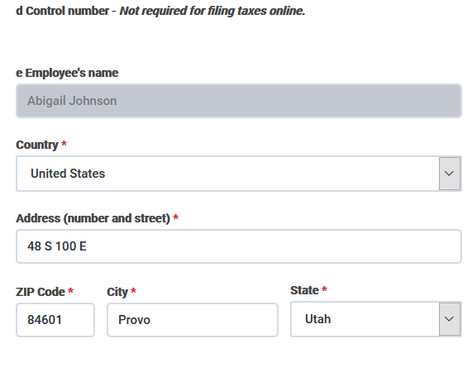
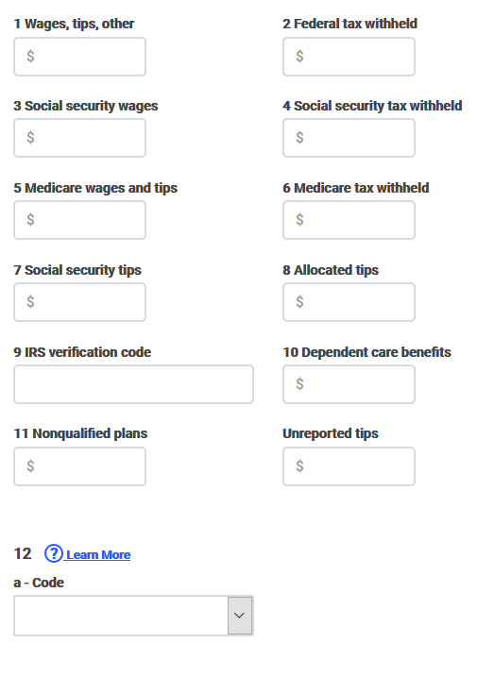
Enter the information reflected on your W2 exactly.
Verify that your address is correct
Your employer should not have withheld these taxes. But you must enter the amounts exactly the way it is reflected on your W2.
Enter the EIN found on your W2
Enter your employer name found on your W2
If your employer withheld social security or medicare taxes, you will need to file Form 843 & 8316 to request a refund. You will need to google these forms.
Nonresidents (except for J2 visa holders), do not have to pay social security or medicare taxes.
Enter address of employer found on your W2
Even if your employer withheld social security or medicare taxes, you must enter the amounts exactly the way it is reflected on your W2.

Slide 41
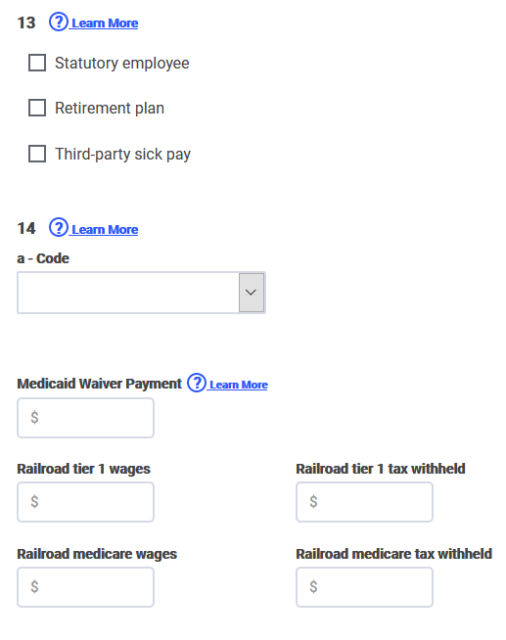
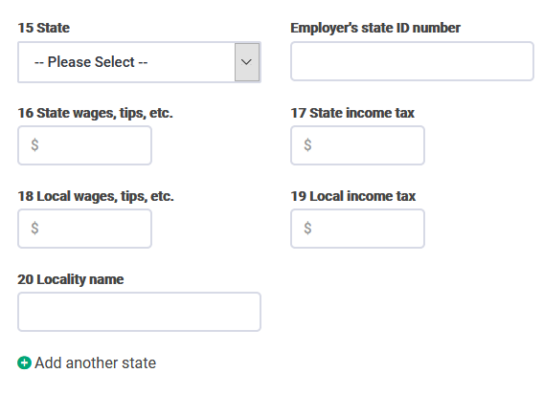

W2 (continued)
Do not include dashes.
Continue to copy your W2 exactly
You should have state information on your W2.
Copy your W2 exactly
If you have multiple W2s, you will need to add another W2 form.
Click CONTINUE

Slide 42
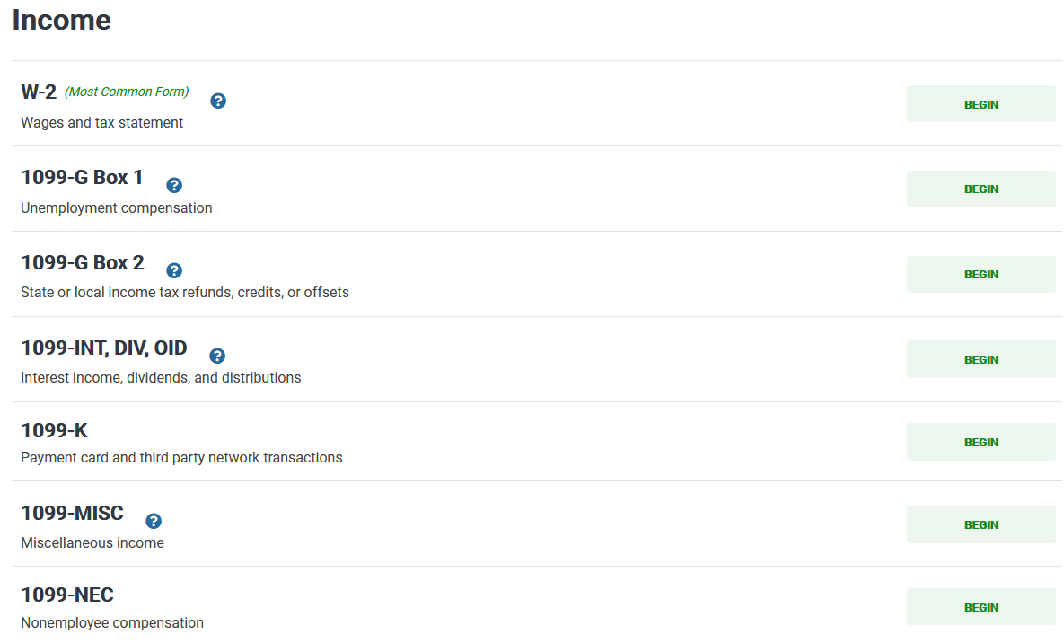
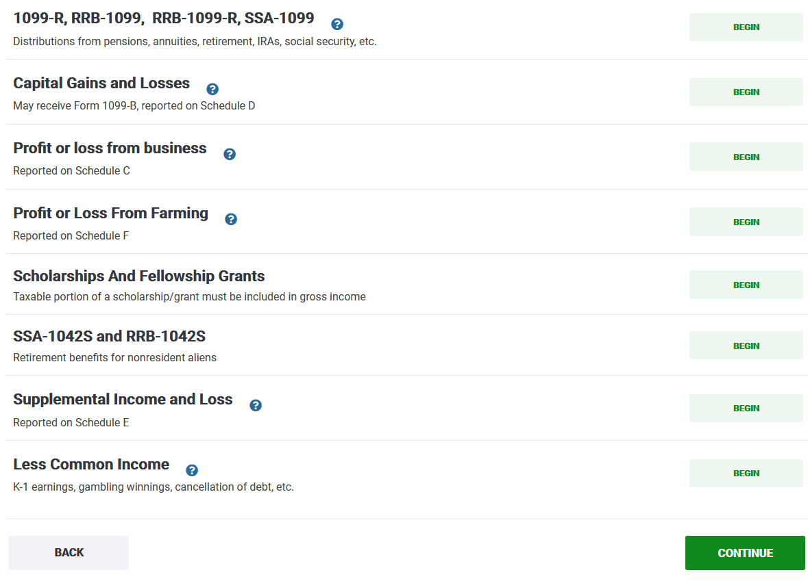
Did you receive Form 1099-G?
If you received prior year state or local refund for a 1040 NR return, you should have received Form 1099-G from the state.
Report this in the Other Income section.
Scroll down
Click on Less Common Income> Other Income Not Reported Elsewhere Income>Other Income No Reported Elsewhere. In the drop-down box, choose Other Income.
This entry does require a description, which could be “Prior Year State and Local Refund.”
Enter amount of refund from state of Utah.

Slide 43
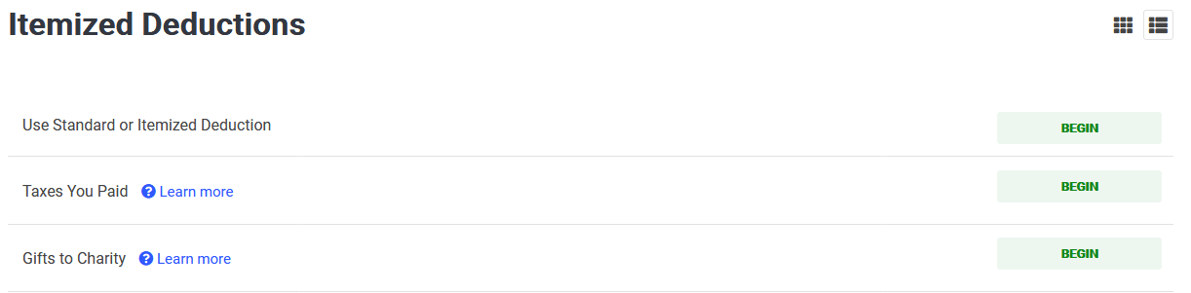
Did you make any donations in 2024? If so, click Deductions…
Reporting Donations
Click Deductions if you made donations to a charity in 2024. Students or scholars who paid tithing to The Church of Jesus Christ of Latter Day Saints can report donations here.
Click Itemized Deductions
Click Gifts to Charity. View next slide…

Slide 44
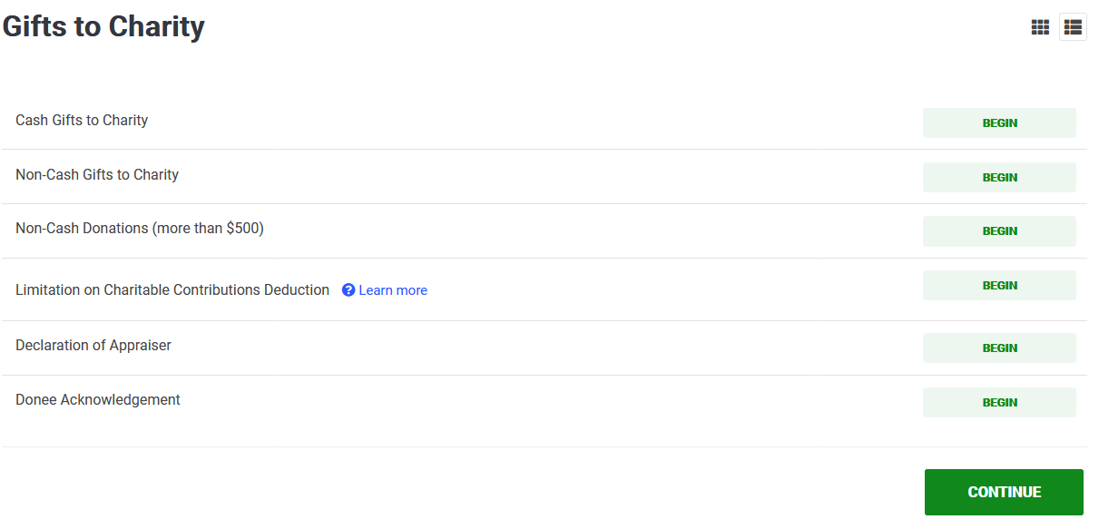

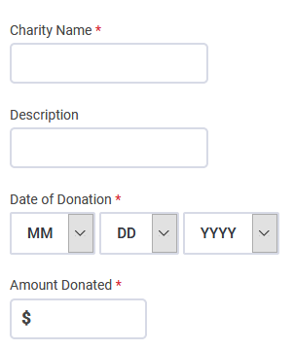
Reporting Donations (Continued…)
Click Cash Gifts to Charity
Click CONTINUE
Type name of charity, enter description (i.e. Donations, or Tithing, etc.), enter the last day you donated, and enter the total amount you donated.

Slide 45
Did you owe additional state and local income taxes in 2023 that were not withheld in your Form W2 and did you make a payment to the state in 2024 when you filed your 2023 tax forms?
You can deduct state and local income taxes you paid during 2024…
Click Deductions
Click Taxes You Paid

Slide 46
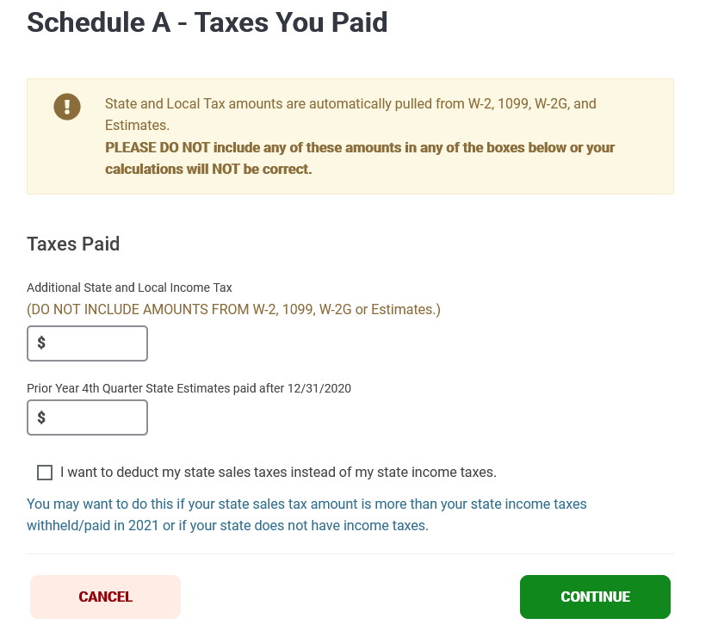
Enter additional state and local income taxes you paid in 2024.
Do not include amounts from W2, 1099, or other income forms you received.

Slide 47
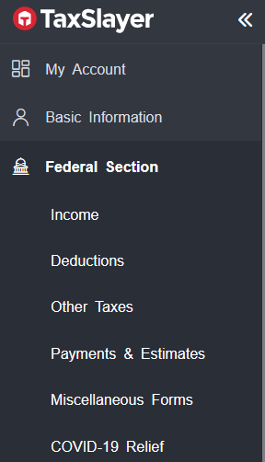
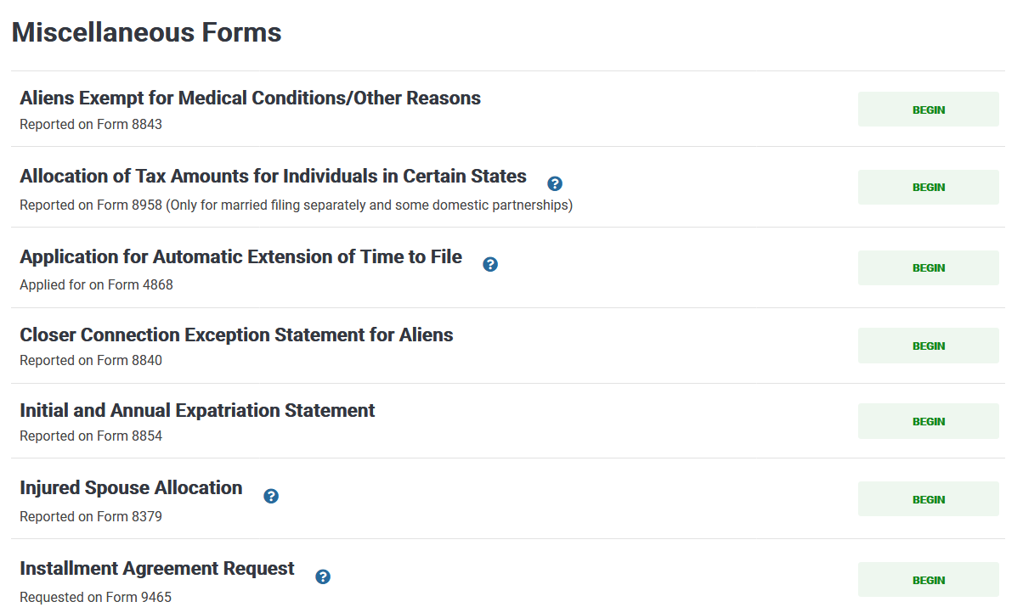
Click Miscellaneous Forms
Click on Aliens Exempt for Medical Conditions/Other Reasons to fill out Form 8843.

Slide 48





Enter information that corresponds to you
Choose Nonimmigrant if you are on an F or J visa
Choose nonimmigrant visa you held when you first entered the U.S.
Enter date you first entered the U.S. on visa you indicated above.
Enter number of days you were present in the U.S. in 2024, 2023, and 2022
If you changed your visa status while you were in the U.S., mark YES.
Enter your current visa status
This number should match number of days you indicated you were present in 2024.

Slide 49

If you are a scholar, click on Part II.
If you are a student, click on Part III.

Slide 50



If you attended BYU in 2024, copy this information exactly.
If you did not attend BYU in 2024, this information does not apply to you. Please enter the information for the university you attended in 2024.

Slide 51

Form 8843, Part II or Part III Continued
Answer these questions according to your situation

Slide 52


State Return
Click State Section to complete your state return.
Click GET STARTED

Slide 53

Choose state you worked in last year (2024)
Click CONTINUE

Slide 54

Choose residency status based on definitions provided below
Click CONTINUE

Slide 55

Click Continue

Slide 56


If you are a RESIDENT of Utah, click Exit Utah Return.
If you are a PART-YEAR RESIDENT of Utah, click Basic Information.

Slide 57

Basic Information (This Section is for Part-Year Residents of Utah
Enter date you arrived in Utah in 2024
Enter date you departed Utah in 2024. If you did not depart, enter 12/31/2024
Click Continue

Slide 58


Slide 59

Click Yes, Add More Items

Slide 60



INTEREST INCOME FOR DEPOSIT (Income Code 01 Listed on Form 1042-S Box 1)
To report Form 1042-S for Interest Income from your deposit, you must enter information in TWO places.
First place: Click Other Taxes > Tax on Income Not Effectively Connected to US Trade/Business (Schedule NEC)
See next slide to continue instructions

Slide 61

Click Other Interest
See next slide for more instructions.

Slide 62



Enter gross income found in Box 2 on Form 1042-S in the corresponding Rate of Tax box in TaxSlayer
To determine corresponding Rate of Tax, view Rate of Tax found in Box 3b on Form 1042-S
IMPORTANT
If your Form 1042-S indicates your tax rate is 0%, enter your gross income amount in the box titled, Custom Rate of Tax 1.
Click Continue >Custom Tax Rates & Enter 0.00 in the box titled Custom Tax Rate 1

Slide 63


Second place:
In addition to entering the gross income, you must enter the rest of the Form 1042-S information in the Form 1042-S section in TaxSlayer.
  Click Payments & Estimates
  Click Foreign Person’s U.S. Source Income Subject to Withholding (Form 1042-S)

Slide 64




Chapter 3 Status Code *
Box 3a
If TaxSlayer Requests this Box
Box 2
Box 5
Box 6
Box 7a
Box 8
Box 11

Slide 65

Select chapter
Please Select
Tax Rate
Chapter 3 Status Code
(if TaxSlayer Requests this box)

Slide 66



Did you receive Form 1042-S for a Scholarship that exceeded tuition, books, and fees?
(Income Code 16 Listed on Form 1042-S Box 1)
If you were awarded a scholarship that exceeded tuition, books, and fees in 2024, you should have received Form 1042-S. (Check your Sprintax account or My Financial Center on the BYU website. )
Note: Do not enter scholarship amount in this section if you have a scholarship treaty. If you have a scholarship treaty, only enter your 1042-S information in the 1042-S section (next slide).
Do you have a scholarship treaty? Please view here (page 13)
to ensure that your country of residence has a scholarship treaty.
If you have a scholarship treaty, DO NOT enter the scholarship
amount in this section. But be aware that you must still enter your
Form 1042-S information in the 1042-S section on the website
(view next slide).
Enter the Gross Income amount in TaxSlayer. You may find the Gross Income on box 2 on your Form 1042-S.

Slide 67
Did you receive Form 1042-S?
(Income Code 16 Listed on Form 1042-S Box 1)
In addition to adding your gross income on the Scholarship and Fellowship Grants tab, you must enter the rest of the 1042-S information in the Form 1042-S section: Foreign Person’s U.S. Source Income Subject to Withholding.

Slide 68
Chapter 3 Status Code *
Box 3a
If TaxSlayer Requests this Box
Box 2
Box 5
Box 6
Box 7a
Box 8
Box 11

Slide 69
Select chapter
Please Select
Tax Rate
Chapter 3 Status Code
(if TaxSlayer Requests this Box)

Slide 70


Marketplace Insurance
Did you have Marketplace Insurance? If so, click on Health Insurance.
You should have received Form 1095-A. You will need your form 1095-A to complete this section
If you had Marketplace insurance in 2023, mark box YES.
If you are not sure how to fill out this section, please set up an appointment with a VITA volunteer.

Slide 71


Slide 72


Only answer YES if you were NOT considered lawfully present in the U.S.
Usually, the answer is YES.
Answer this question according to your situation. Please view your Form 1095-A to help you answer this question.

Slide 73


If you answered NO, enter the amounts below for each month you had Marketplace insurance. Copy your Form 1095-A
If you answered YES, view your Form 1095 to enter each box below.

Slide 74


Save Your Return
Click View Return to generate a pdf. Save the pdf so you have your 2024 tax return for future years.
*Make sure when you view your return that you generated Form 1040NR.

Slide 75

E-file
Before you e-file,
Ensure you generated Form 1040NR.
Save your tax return.
If you have a scholarship that exceeded tuition, books and fees, do not e-file yet. If you paid the international student deposit before Winter 2024 do not e-file yet. BYU will issue you Form 1042-S after March 15th and you must report this form on your tax return. After obtaining Form 1042-S, visit our walk-in hours so we can help you enter information regarding your Forms 1042-S.
Ensure that your tax return is complete and accurate.

Slide 76


Slide 77


E-file
The program will ask you to click on CONTINUE for each section. Make sure that each section looks accurate.
Note: If a Validation Error screen pops up for the state return, it is likely you have made an error on your return. Read the error listed on the screen. A common mistake is that you may have entered dashes (-) when entering the employer’s state ID number on the W2 section. If this is the case, you will need to go back to your W2 and delete the dashes.
Click CONTINUE.
Important: Taxpayers do not need to pay a fee when preparing a return through TaxSlayer.

Slide 78

Select the way you wish to receive your FEDERAL refund.
If you owe money, select the method you wish to make a payment.

Slide 79

Select the way you wish to receive your STATE refund.
If you owe money, select the method you wish to make a payment.

Slide 80

E-file
You have the option to verify your identification to the state of Utah.
If you have a U.S. issued I.D., you have the option to enter your I.D. information.
* This section is optional.

Slide 81

In order to e-file, TaxSlayer requires that you enter your 2023 Adjusted Gross Income if you filed a 2023 tax return.
Options
Check, Yes, I have my 2023 tax return with me if you filed a 2023 tax return and you have your 2023 tax return. You may find your 2023 AGI on line 11.
Check No, I can’t locate my 2023 tax return if you can’t locate your 2023 return. If you filed a 2023 tax return and you have your Self-Select PIN from last year’s return (if you filed using this website), you may enter your PIN.
Check, No, I didn’t file a 2023 tax return if you did not file taxes last year.

Slide 82

Create a PIN and remember your PIN
Remember your PIN for next year and please save your 2024 tax return.

Slide 83

LAST STEPS
1. Enter bank Information & E-file, if you choose Direct Deposit or Direct Payment (if you owe taxes)
  Enter your bank information. Ensure that your routing number and account number are correct.
  Sign and submit your tax return
2. Check the status of your tax return after e-filing
  Return to your TaxSlayer account and check the status of your return to ensure your tax return was e-filed.
  You may check your return by logging back into your account and going to My Account.

Slide 84
If TaxSlayer does not accept your tax return and it does not allow you to e-file, you will need to mail your forms
Send your federal tax forms (Form 1040NR and Form 8843) to:
Department of the Treasury
Internal Revenue Service
Austin, TX 73301-0215 USA
Returns with refunds
If you still wish to e-file, you may set up an appointment with the Low Income Taxpayer Clinic so they may assist you in filing your taxes. You may call them at 801-210-8001.
Department of the Treasury
Internal Revenue Service
P.O. Box 1303
Charlotte, NC 28201-1303 USA
If enclosing a payment

Slide 85
Mail your Utah state forms to:
All returns with payments:
Utah State Tax Commission
210 North 1950 West
Salt Lake City, UT 84134-0266
Utah State Tax Commission
210 North 1950 West
Salt Lake City, UT 84134-0260
All other returns, including refunds:

Slide 86
Treaty for Canadians
Canada Treaty Article 15
Students and scholars are permitted to use Article 15 of the tax treaty.
The tax treaty with Canada is different from most other tax treaties because it (1) exempts all earned income if the nonresident earned not more than $10,000 in the tax year, but (2) taxes all income if the nonresident earned more than $10,000.
This treaty benefit is lost if the nonresident becomes a resident for tax purposes.

