Slide 1

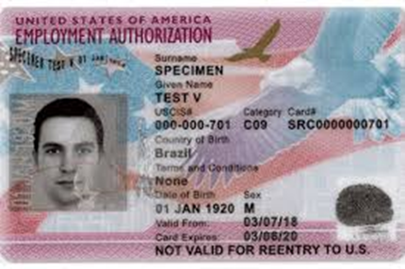
Standard OPT Online
Application Template
Disclaimer:
Our office provides this template information to you as a courtesy with the understanding that you are ultimately responsible for the completeness and accuracy of the information you will enter into your USCIS online application.
Your answers may vary from the ones in the template depending on your current circumstances. Please read each slide carefully so that you can successfully complete the required USCIS OPT online application.
Notes:
Photo credits: uscis.gov

Slide 2
CAUTION!
DO NOT SUBMIT YOUR USCIS OPT ONLINE APPLICATION UNTIL AFTER YOU HAVE RECEIVED
AN OPT RECOMMENDATION I-20 FROM OUR OFFICE AND
A CPT Screenshot
OR
YOUR APPLICATION WILL BE DENIED

Slide 3
IMPORTANT DATES!
USCIS must receive your OPT Form I-765 online application:
No earlier than 90 days before you graduate and no later than 60 days after you graduate; and
No later than 30 days from the creation date of your OPT recommendation I-20 next to your DSO’s signature on page 1.
If you have any questions about the timing, please contact our office.

Slide 4
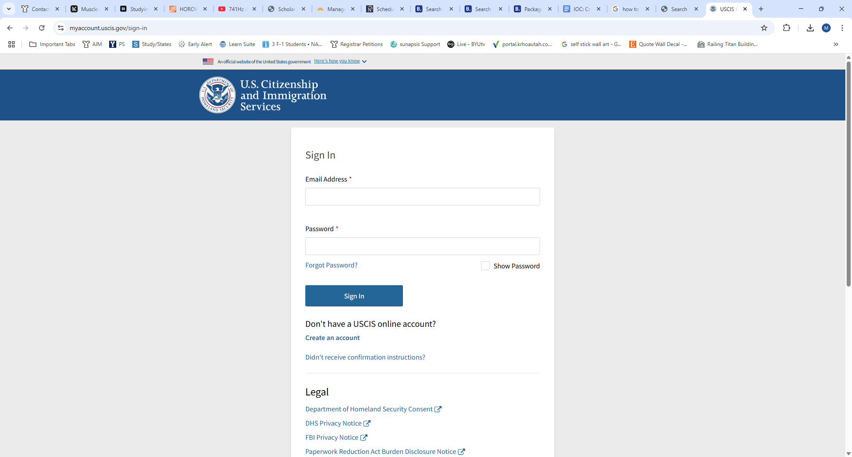
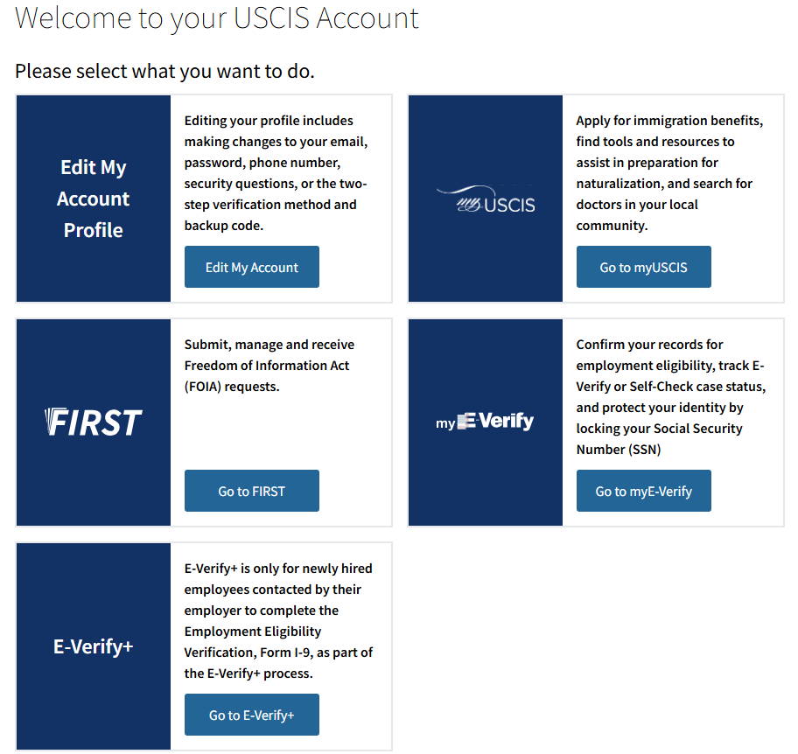
HOW TO
Begin your USCIS application
DO NOT have an account?
Create your account
Go to USCIS.gov
Click on “Sign In”
Click on “Create Account”
Then, select
Click on “File a form online”
SKIP NEXT SEE NEXT SLIDE

Slide 5
HOW TO
Begin your USCIS application
DO have an account?
Login at https://myaccount.uscis.gov/sign-in
Then select
Click on “File a form online”
SEE NEXT SLIDE

Slide 6
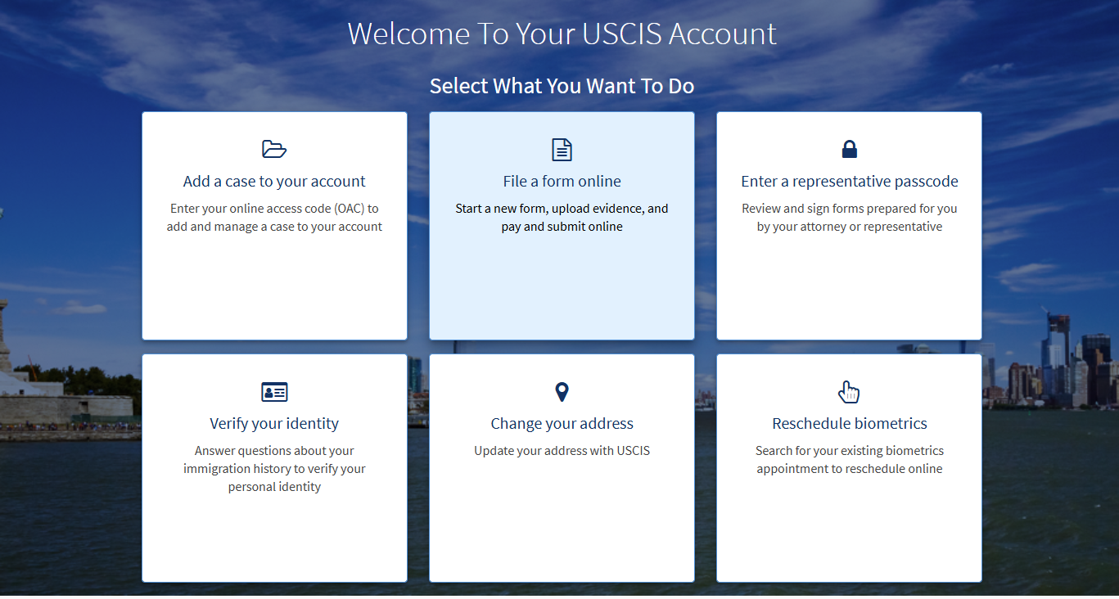

Slide 7
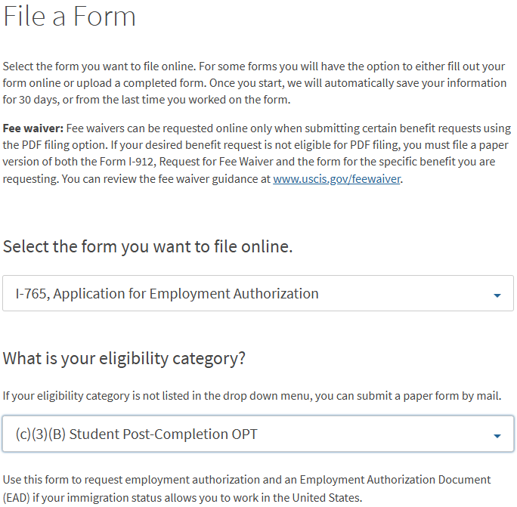
File a Form
Select:
  I-765, Application for Employment Authorization
  And
  (c)(3)(B) Student Post-Completion OPT
Then click on Start Form

Slide 8
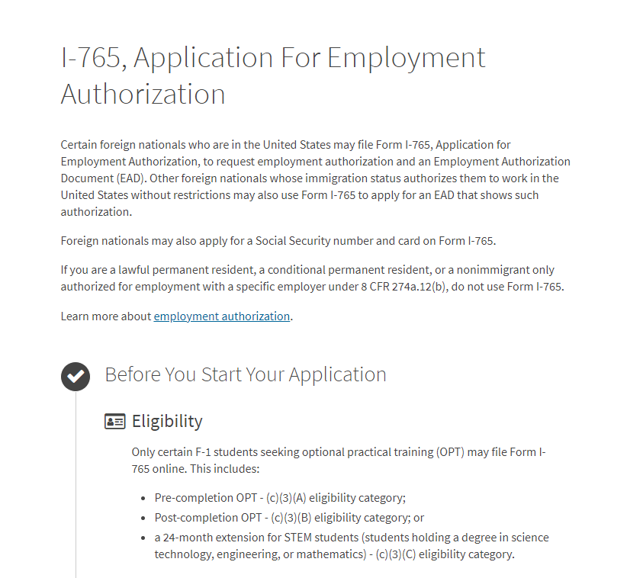
IMPORTANT!
Please read information carefully.
AFTER you have read through this information, click the Next button at the bottom of the page.

Slide 9
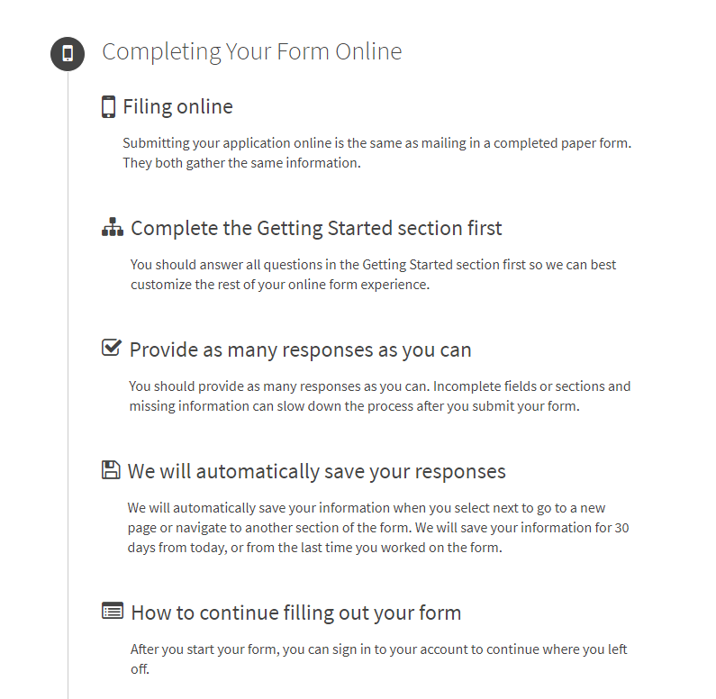
Please read the information on this page so you will understand how to proceed.
Then, click the Start button at the bottom of the page.
Note: You may save your application as a draft if needed.
You may then reopen it to edit and make additions as needed before submission.

Slide 10

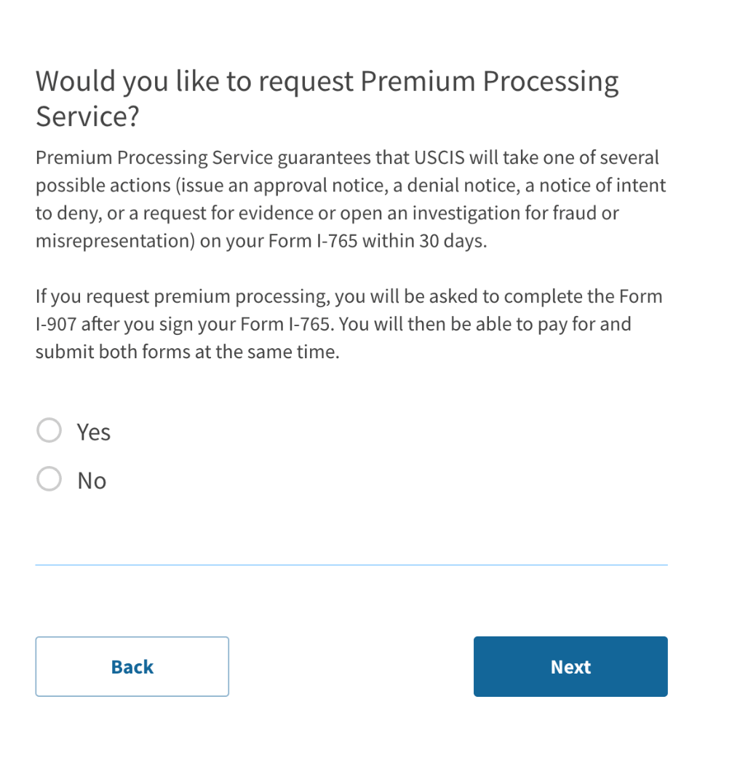
Quicker Processing Time Option
You can expect that your application will be processed within three months. Often it is less.
However, if you want your application processed sooner, you may choose to pay the $1,685 premium processing fee by selecting “yes.”
Otherwise, select “no.”
Click Next at the bottom of the page.

Slide 11
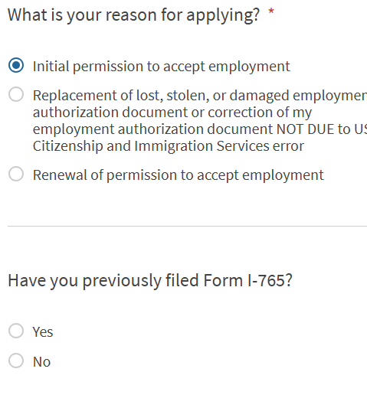
Reason for applying
Choose Initial permission to accept employment.
Have you previously filed Form I-765?
If this is your first time to use Form I-765, select No.
If you have filed Form I-765 for previous employment, please select Yes.

Slide 12
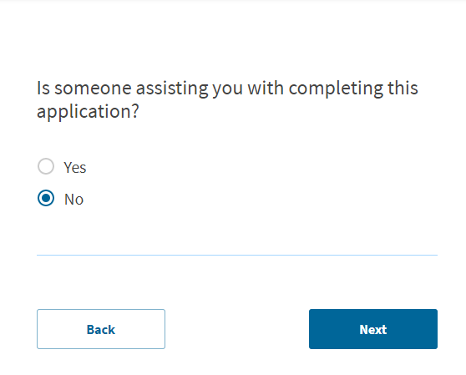
Preparer and interpreter information
Select No unless you have hired someone to assist you in filling out the application.

Slide 13
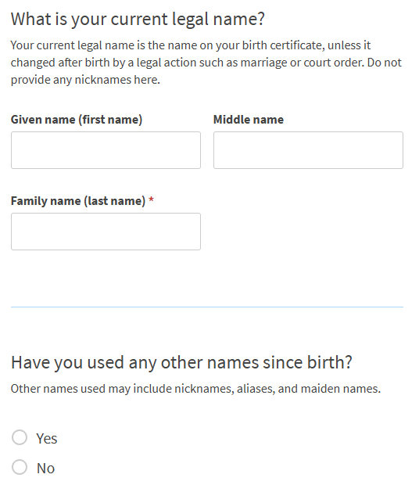
Current Legal Name
Enter your legal name as listed in your passport
If you have used any other names since birth, answer YES and enter them.
If not, answer No.

Slide 14
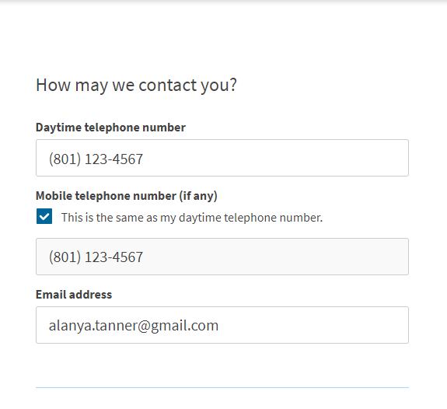
Contact information
List your non-byu email address

Slide 15
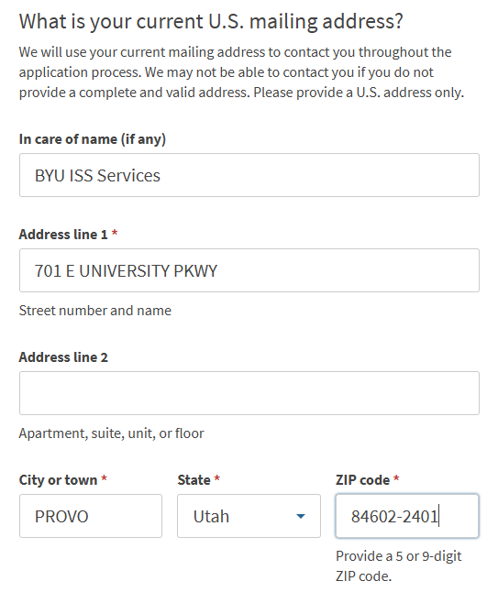
Current U.S. mailing address
List your mailing address.
If you will move to another address before the OPT application is adjudicated, consider renting a post office box and using that address. The U.S. Post Office located on campus (1010 WSC) offers inexpensive monthly rentals.
ISSS is unable to accept mail for students.
2400 WSC

Slide 16
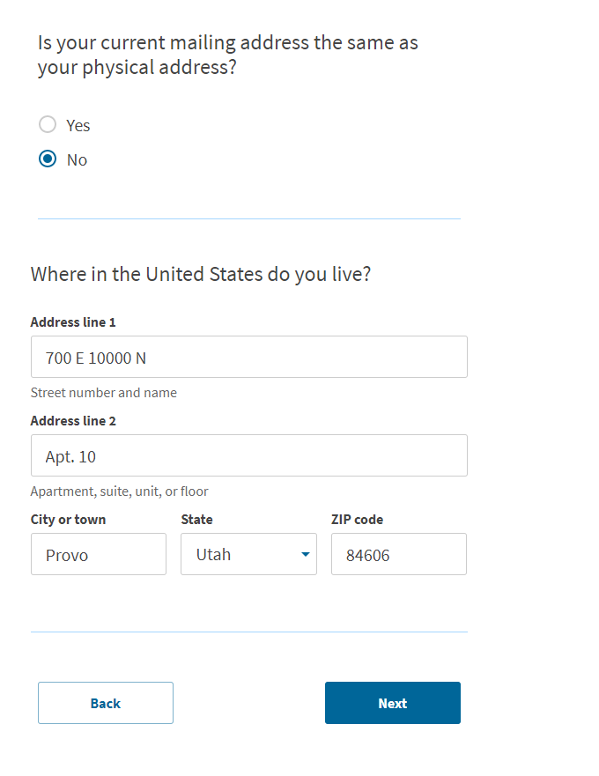
Mailing and physical addresses
If you used a mailing address other than your physical address:
Select NO
Provide your current residential address
Select NEXT
If you entered your physical address:
Select YES
Select NEXT

Slide 17
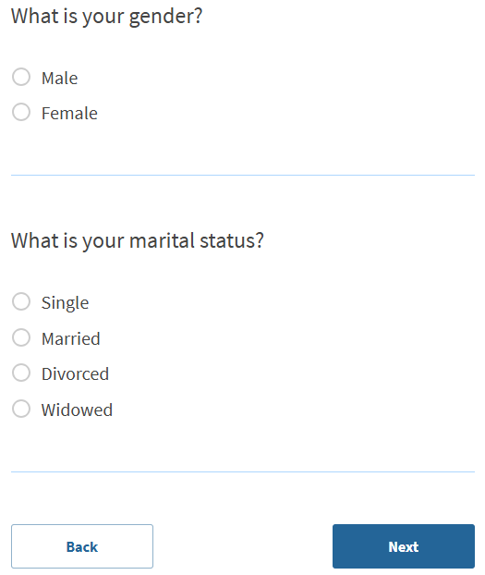
Enter your personal information

Slide 18
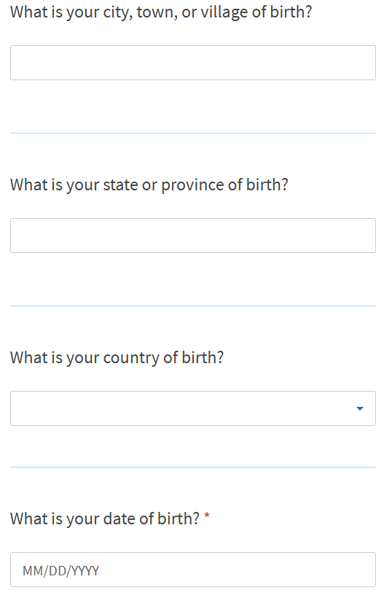
Enter where and when you were born

Slide 19
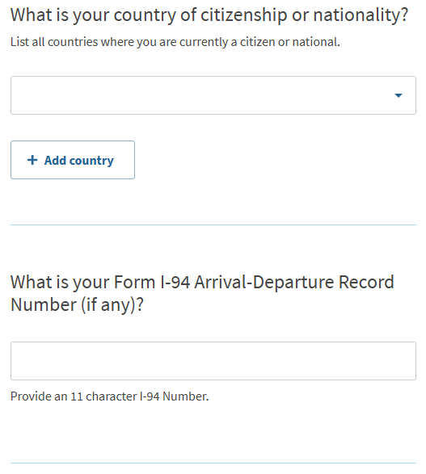
Your immigration information
Your Form I-94 can be found at i94.cbp.dhs.gov
Select “Get Most Recent I-94” and fill out the required information
The I-94 number can be found at the top of your I-94 record
Save a copy of your I-94 as a PDF to your computer since you will need to upload it later.

Slide 20
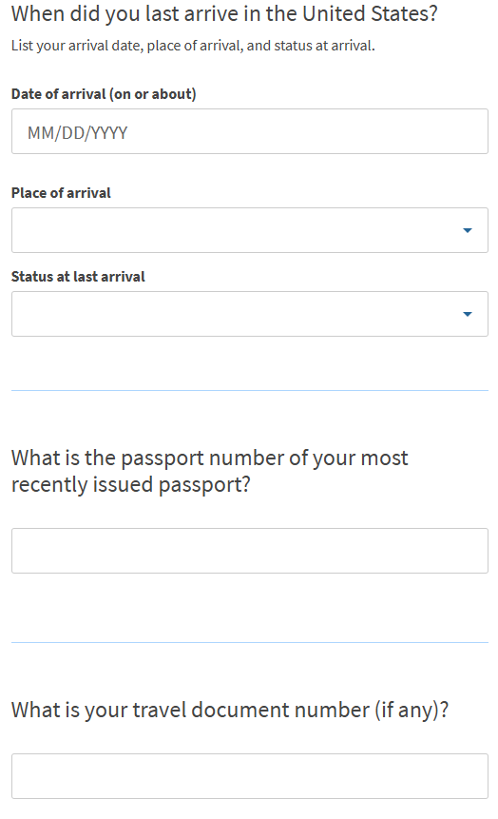
Your immigration information cont.
Enter the status of your last arrival, usually F-1 unless you changed status in the U.S. by application since you last entered. If so, choose your last arrival status and not F-1.
It is uncommon to have a travel document number. You would know since you would have previously applied for one with USCIS.

Slide 21
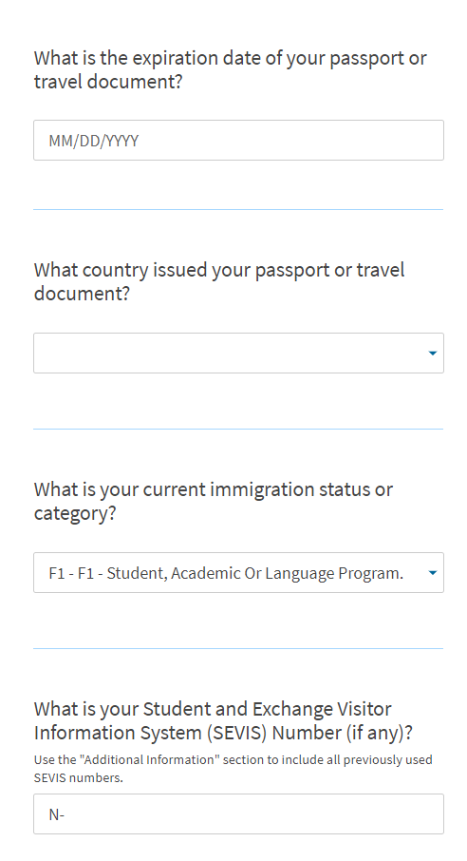
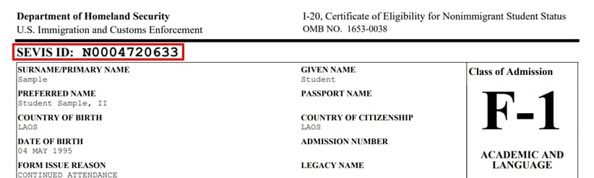

Your immigration information cont.
Your SEVIS Number can be found at the top of your Form I-20. It starts with the letter N.

Slide 22
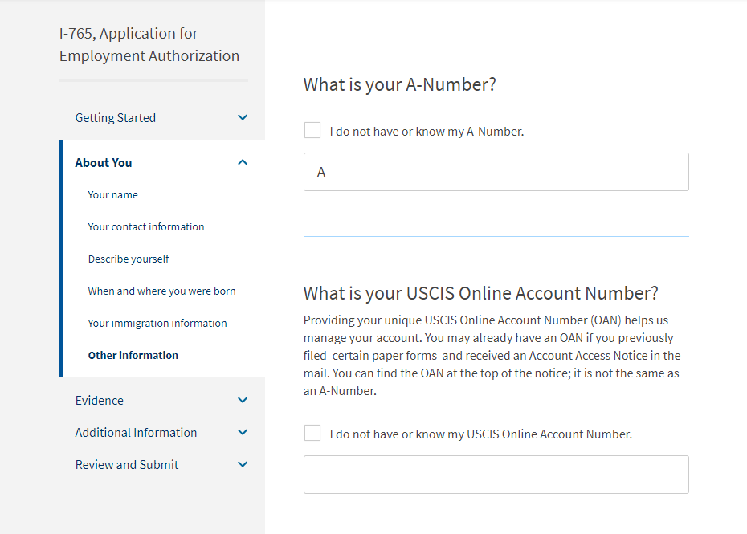
Other information
A-Number
If you have previously applied for OPT, the A-Number is listed on your EAD card as USCIS#
If you do not have an EAD card or do not know of an A-Number, check the box.

Slide 23
Other information
You will only have a USCIS Online Account Number if you have previously filed a form online. Your number will then automatically appear here.
If you do not have or know your my USCIS Online Account Number, please check the box.

Slide 24
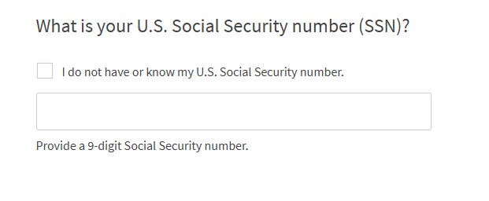
Social Security Card Information
If you do not have or know your U.S. social security number, check the box.
If you have a Social Security number, Enter your U.S. Social Security number.

Slide 25
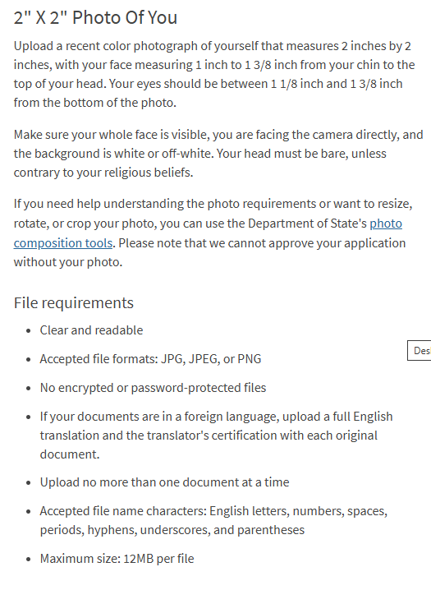
2 x 2 photo of you
Multiple community places provide passport pictures. Please call to inquire about hours and costs:
CVS Pharmacy, 1273 N University Ave, Provo, 801-377-3280
Staples, 971 S University Ave, Provo, 801-370-0170
Walgreens, 1315 N State St, Provo, 801-616-5223
The UPS Store, 223 W Cougar Blvd Provo, 801-379-6120
Ask them to send you the scanned copy of these photos to upload in your application.
You may also try and take a selfie to see if it will be accepted when uploaded.

Slide 26
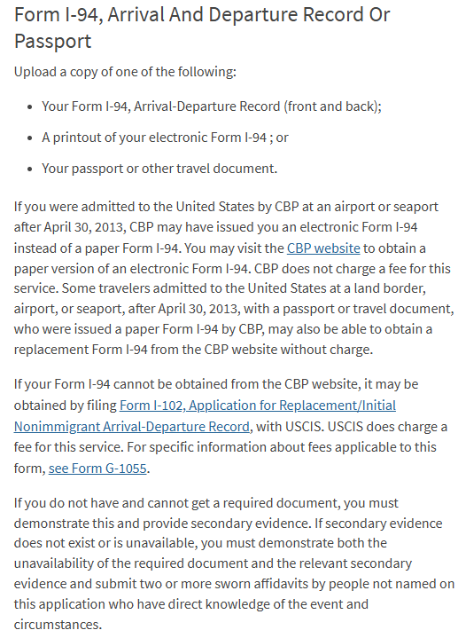
Form I-94 OR Passport
UPLOAD
I-94 record
OR
Passport picture page

Slide 27
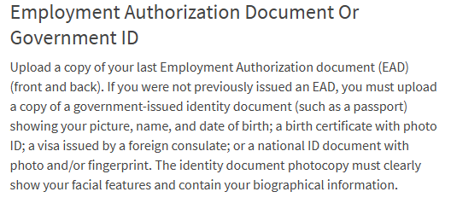

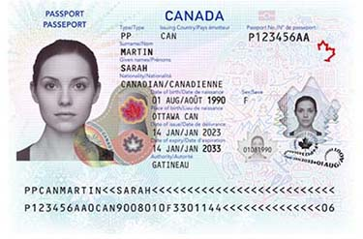
Employment Authorization Document (OPT card) OR Govt. ID
Upload:
copy of any previously issued OPT EAD (OPT card) if you have received one
OR
your passport page
If you need a scanned copy, you may come to our office or use the scanner in the BYU library.

Slide 28
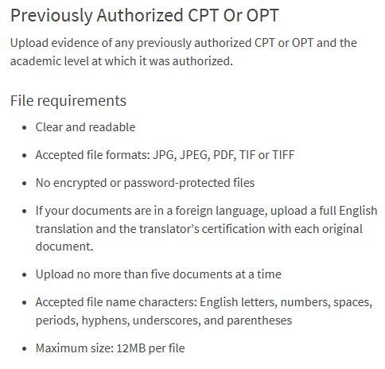
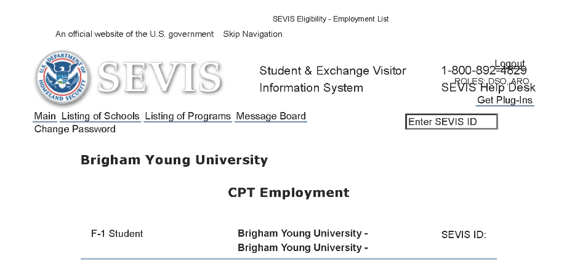
Previously Authorized CPT or OPT
UPLOAD:
CPT screenshot to document your CPT employment even if you have not participated in CPT
AND IF YOU HAVE A PREVIOUS EAD (OPT CARD),
Copy of your EAD

Slide 29
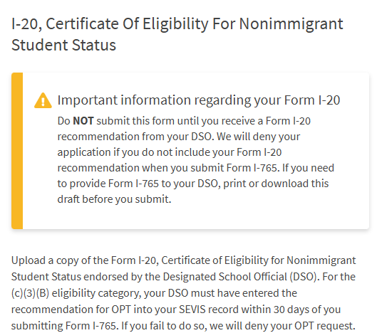

Form I-20
Upload your new ISSS OPT Recommendation I-20 signed by you in ink showing your OPT is requested on page 2

Slide 30
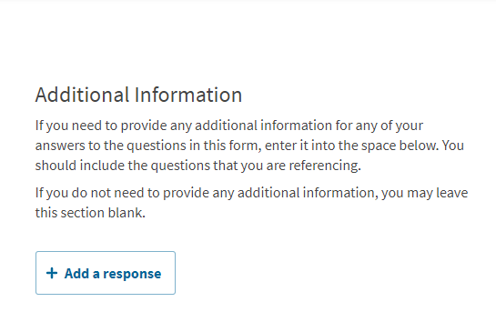
Additional information
Here you can add additional information for your application depending on your personal circumstances and anything that could affect your OPT.
For example, if you entered the U.S. on a previous passport or if your F-1 visa is in the previous passport, we recommend adding your previous passport here.
We recommend talking to the ISSS office about the information you want to put here; however, the majority of students do not need to put anything here.

Slide 31
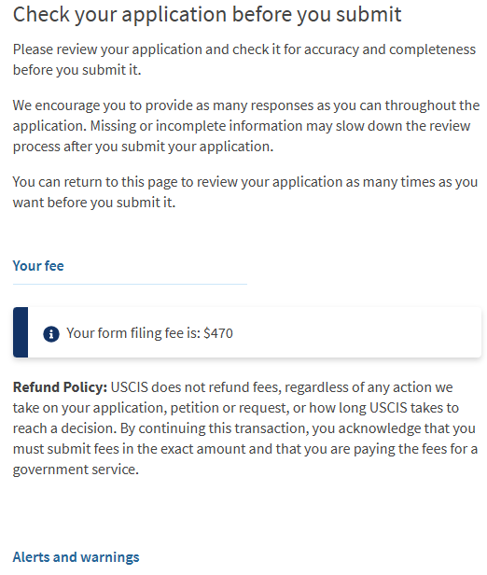
Review your application
Review the information in your application.
Edit any fields that may be needed.
If there are alerts or warnings, be sure to fix them.

Slide 32
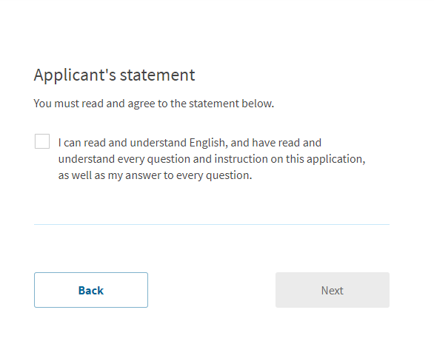
Your statement
Please read this statement and check the box if you agree with it.

Slide 33
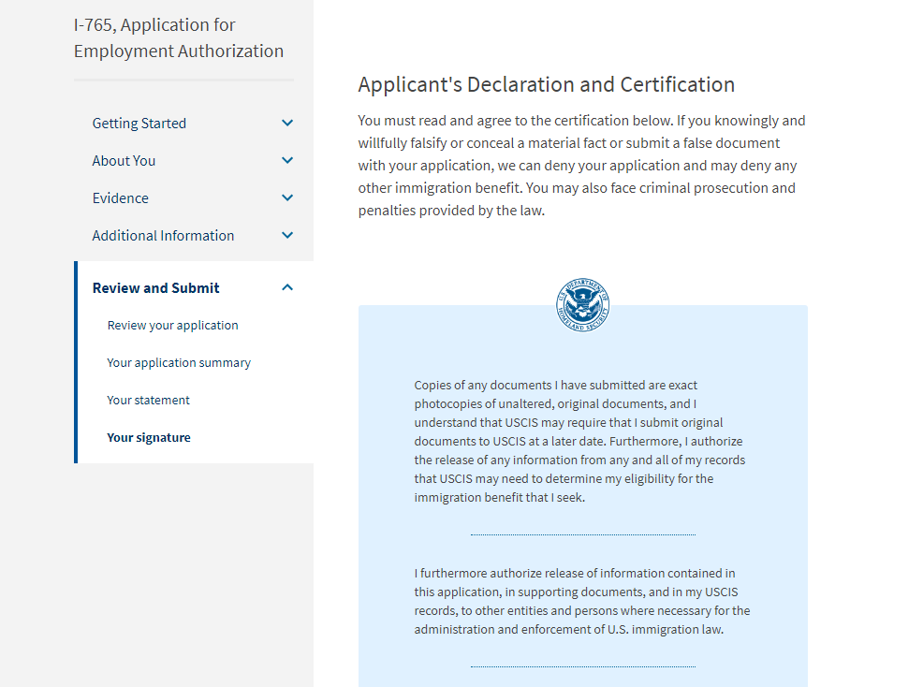
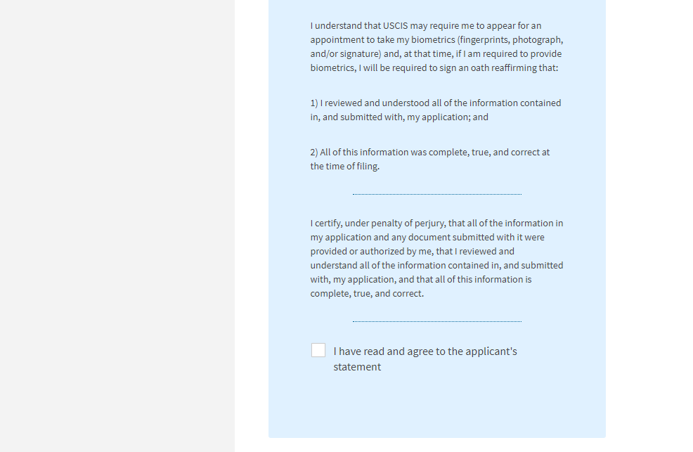
Declaration and Certification
Carefully read this information before checking the box and signing your application.
See next slide

Slide 34
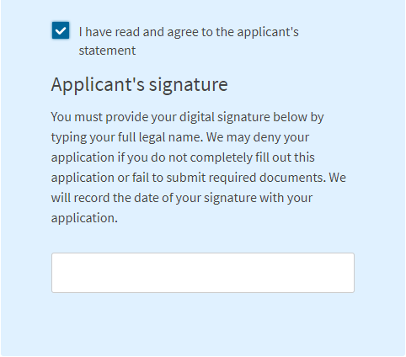
Your signature
Once you have agreed to the statement, be sure to type your full legal name as listed in your passport.

Slide 35
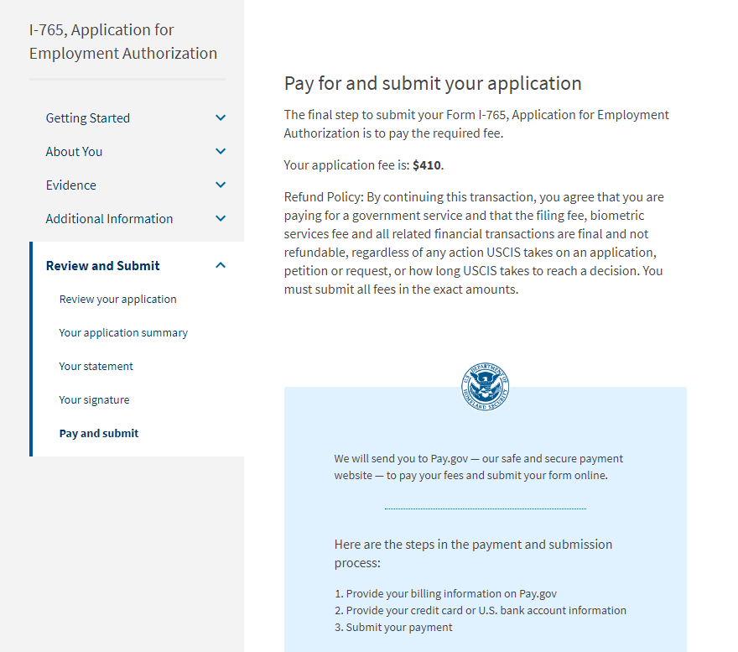
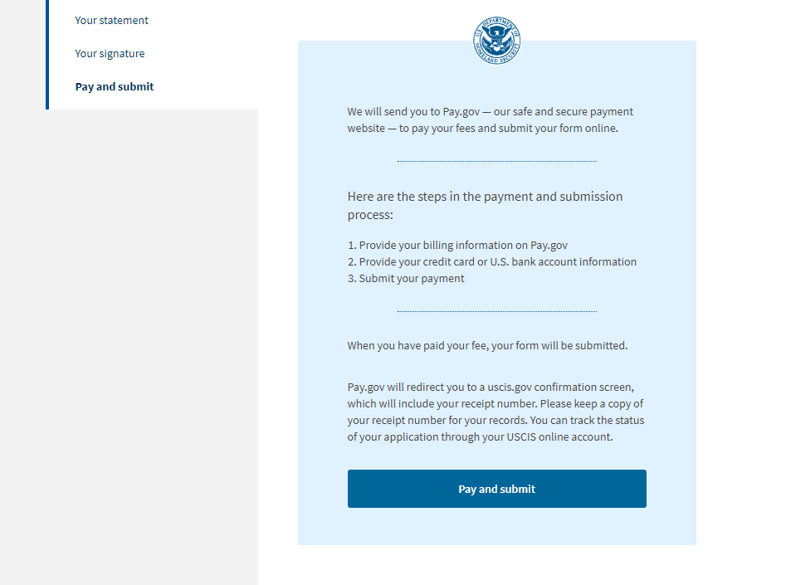
Pay and submit
$470
Please read this information to understand the payment process.
When you are ready to pay, click on the button at the bottom of the page.

Slide 36
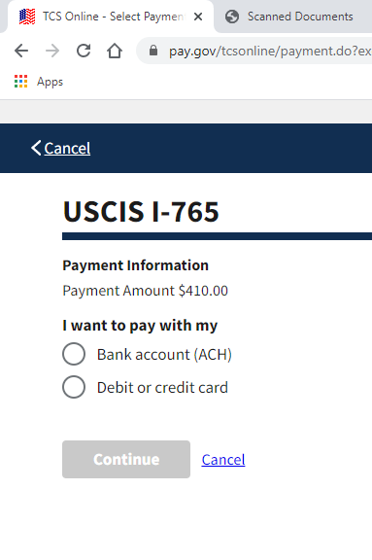
Pay and submit
After you click on "Pay and submit,"
Choose the method you would like to use to pay for your I-765 application and follow the instructions.
Use the billing address as your personal address.
$470

Slide 37
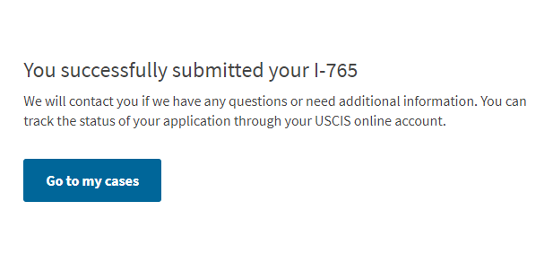
Congratulations!
Once you have paid, you will be shown a notice of your successful submission.

Slide 38
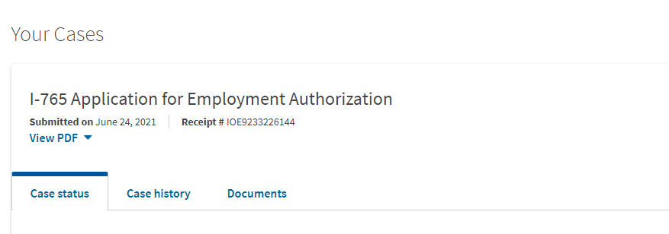
Your cases
You can view the status of your case on the homepage of your USCIS account.

